Slide 1
Developing Strategic Communications
Dr. Timothy Bray

Slide 2
Goal-Oriented Communication Planning
Who is your stakeholder?
What do they need to Know?
What do they need to Think?
So that they’ll do what you need them to do?
What do they need to Feel?

Slide 3

Identifying Stakeholders
By Role or Function
By Affinity
Funder
Supporter
Researcher
Activist
Immigration Reform Activist
Government Spending Watchdog
School Reform Advocate
By Sentiment
Haters
Fans
Die-hard Supporters

Slide 4
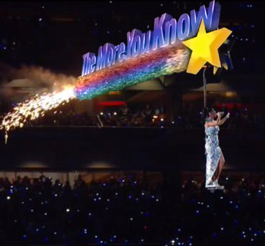
Identifying Desired Action
For each stakeholder, what is it that you want them to do?
What if you want one stakeholder to do more than one thing?
  Do you really have more than one stakeholder?
  Are you actions really the same?
  Maybe you were right in the first place…

Slide 5
Know, Think, and Feel…
Know
What knowledge is required to motivate the desired action?
Think
What thought response would motivate the desired action?
Feel
What emotional response is necessary to motivate the desired action?

Slide 6
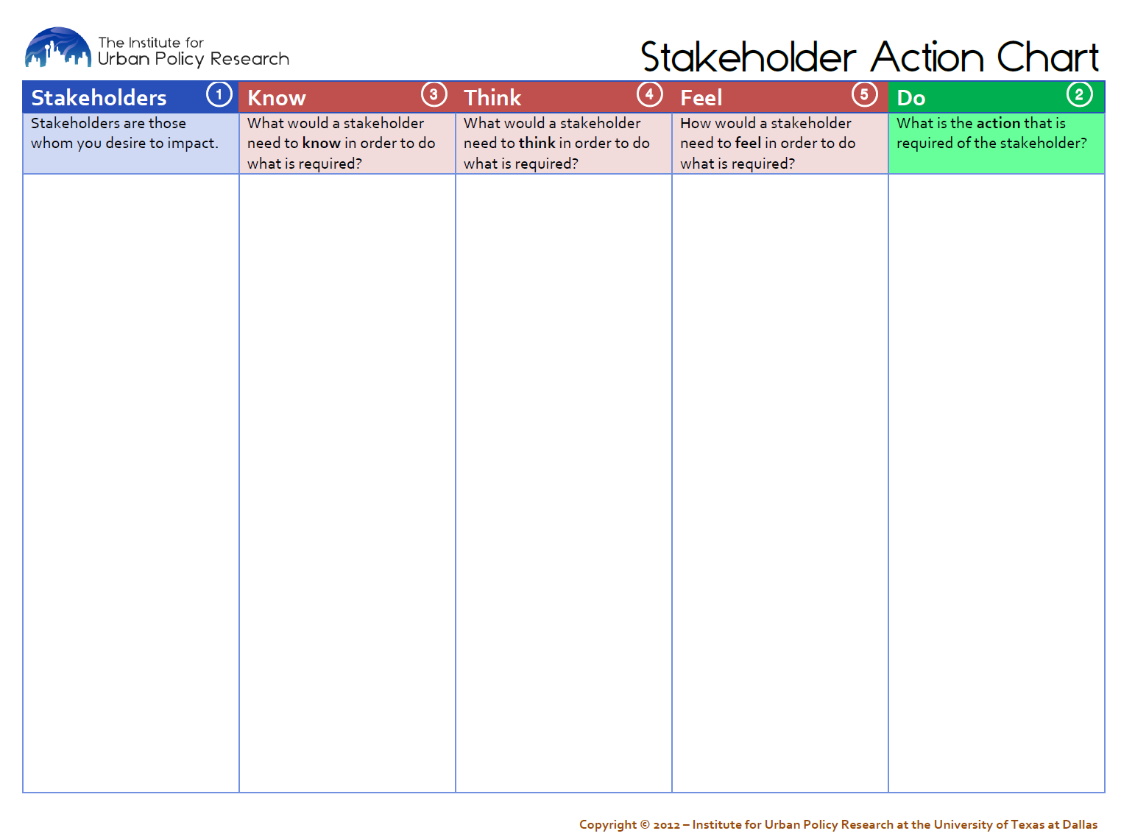
The Stakeholder Action Chart

Slide 7
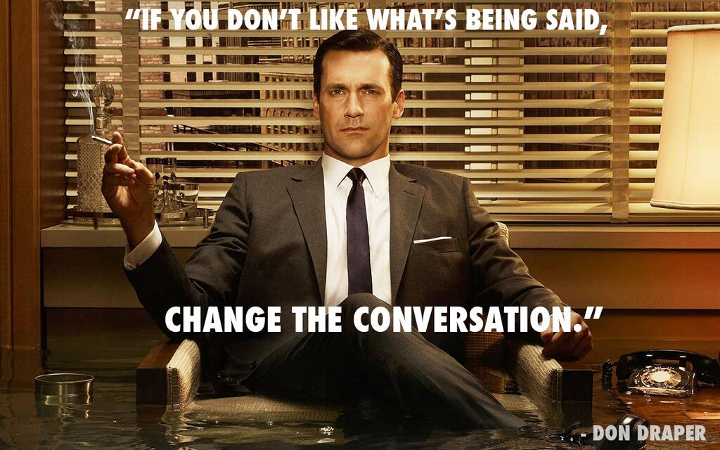
Yes… This Is A Marketing Conversation

