Slide 1
Voter Turnout and Demographic Mapping
Jeff Matson
jmatson@umn.edu
NNIP Idea Showcase
9/24/24

Slide 2
Voter Engagement Questions
What does the population in X location look like, and do they vote?
Where does Y population of non-voters live?

Slide 3
The Data
Precinct-level Turnout from 2022 statewide election
ACS Data on Race/Ethnicity from 2018-2022 5-year estimates (also by precinct)

Slide 4
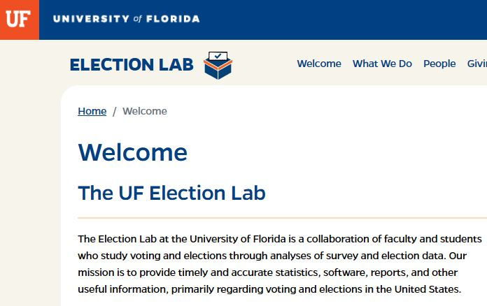
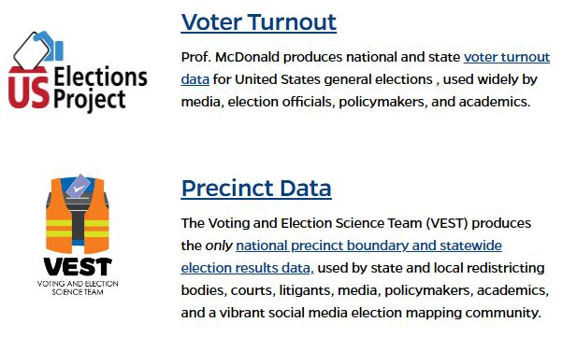
Notes:
# of Votes case / Eligible population
Eligible Voters from US Election Lab (Univ. of Florida

Slide 5
Precinct Demographics
Notes:
Used population weighted block data from 2020 Census

Slide 6
The Map!

Slide 7
Map Pop-ups
Notes:
Important to note what it tells us / and what it doesn’t tell us.

Slide 8
Map Layers
Notes:
Other groups that have difficulty voting or vote in lower numbers
Age 18-24
Age 65+
Renters

Slide 9
More Map Layers
Notes:
Bivariate maps by race/ethnicity & turnout

Slide 10
County Averages
Notes:
H & L are relative to different parts of the State

Slide 11
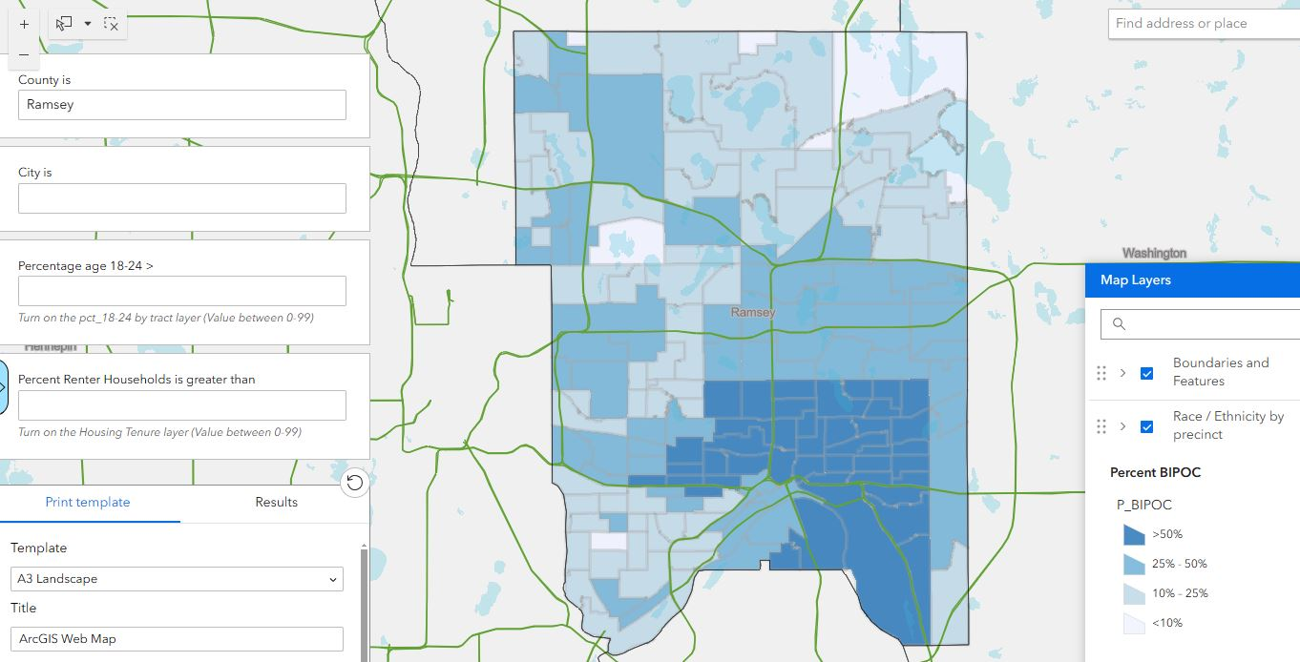
Filter and Download Data
Notes:
City & County filter tools
Data download

Slide 12
Limitations
Does not show turnout by race
High and Low are relative
2022 was a non-presidential election

Slide 13
Voices for Racial Justice
Notes:
Helped Define the issue, develop the map
Created their own version / vision
Taken the lead on training

Slide 14
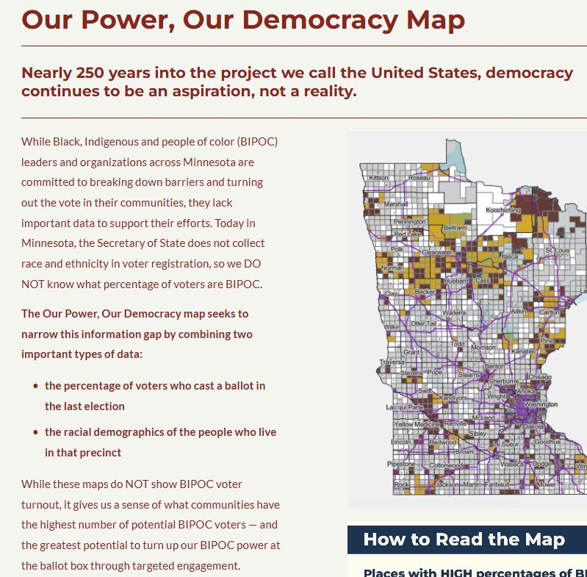

Slide 15
VRJ Lead Trainings
Notes:
List of orgs trained so far
Upcoming trainings

Slide 16
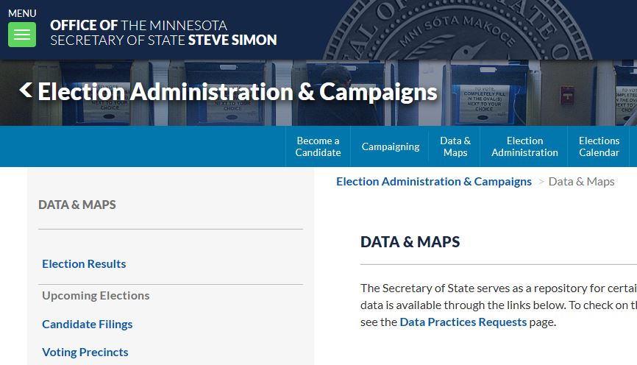

Slide 17
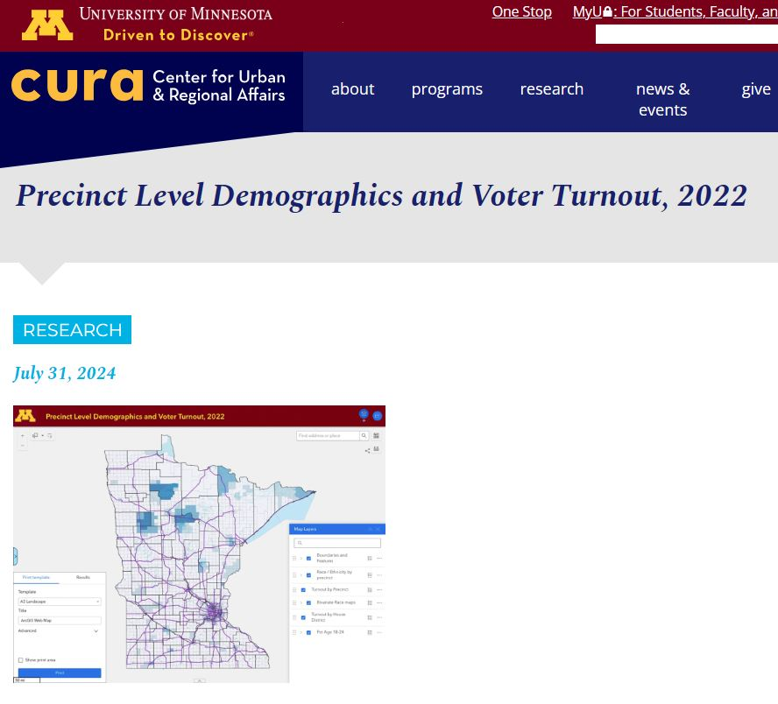
Notes:
Over last two months, 2nd most visited page on our website (only behind the homepage)

Slide 18
Minn Post Article?
If it comes out in time

Slide 19
What’s next?
Update after 2024
Margin of victory
Notes:
Update after 2024 election

Slide 20
VOTE!!!
z.umn.edu/Vote2024
Special Thanks to Deepika Mallika Tamilselvan!
(CURA GRA Extraordinaire)

