Slide 1
The Financial Health & Wealth Dashboard: Leveraging Local Data to Address Racial Wealth Disparities
Link to tool

Slide 2
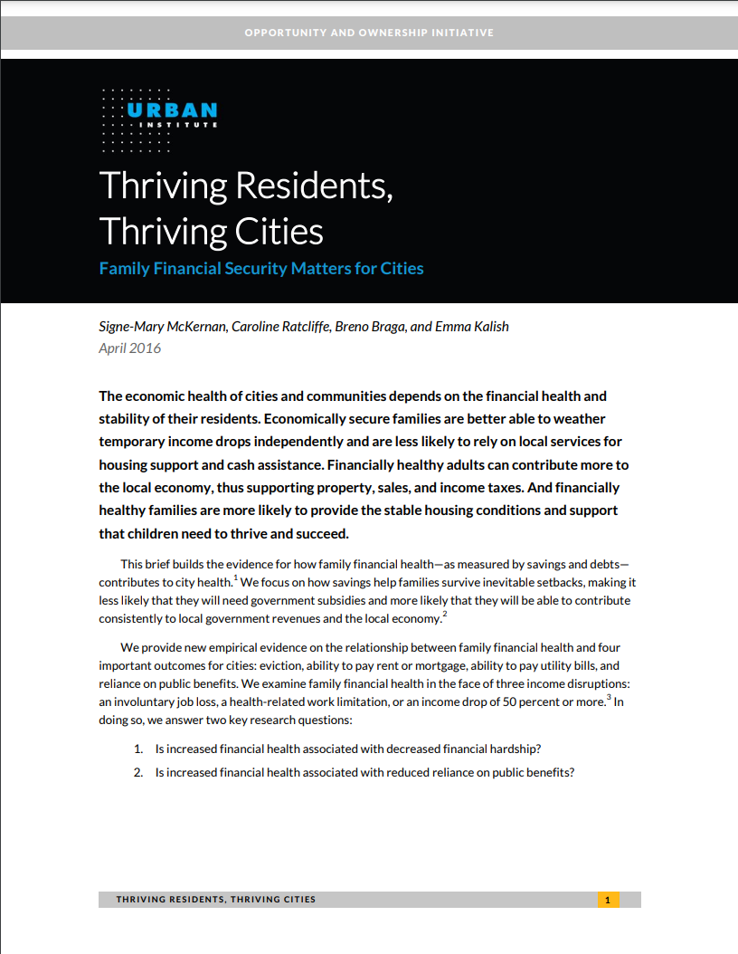
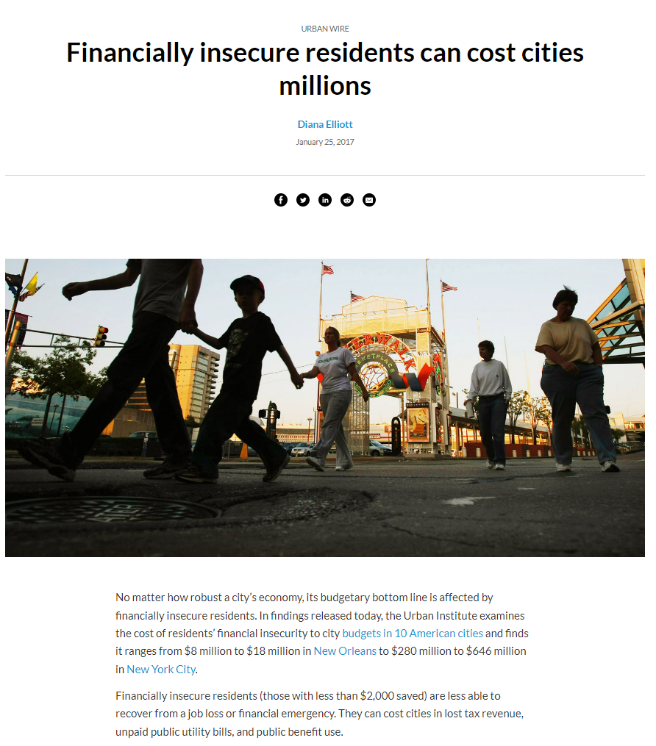
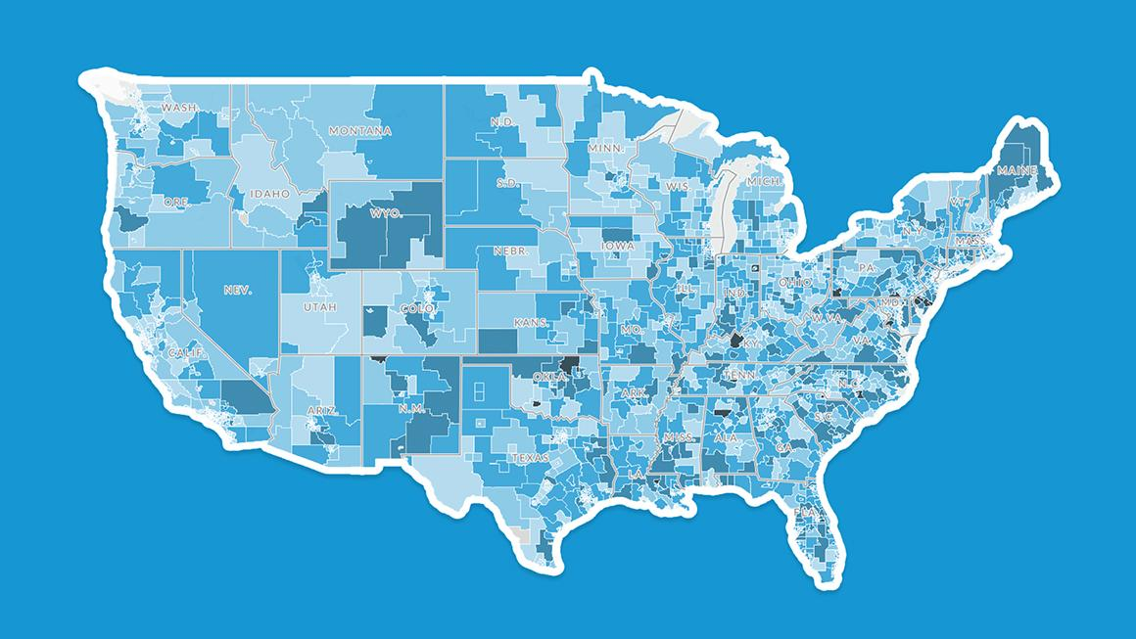
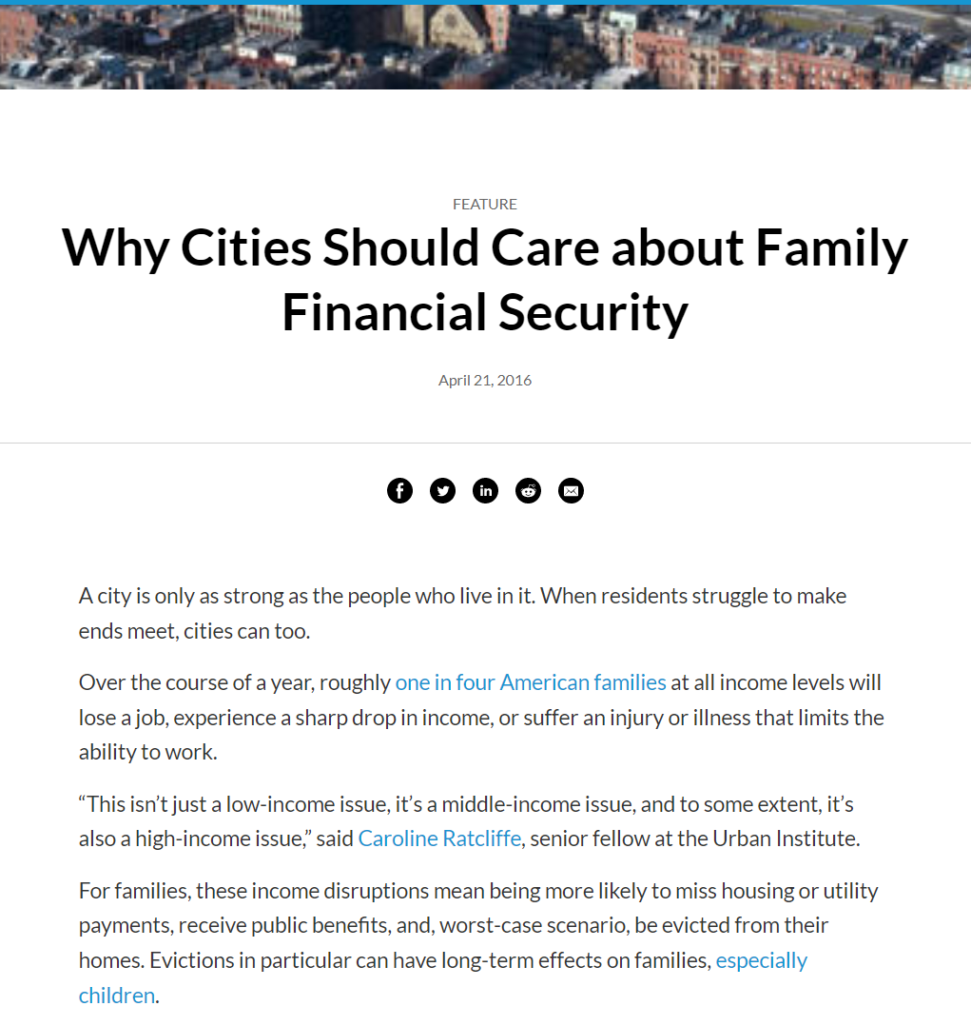
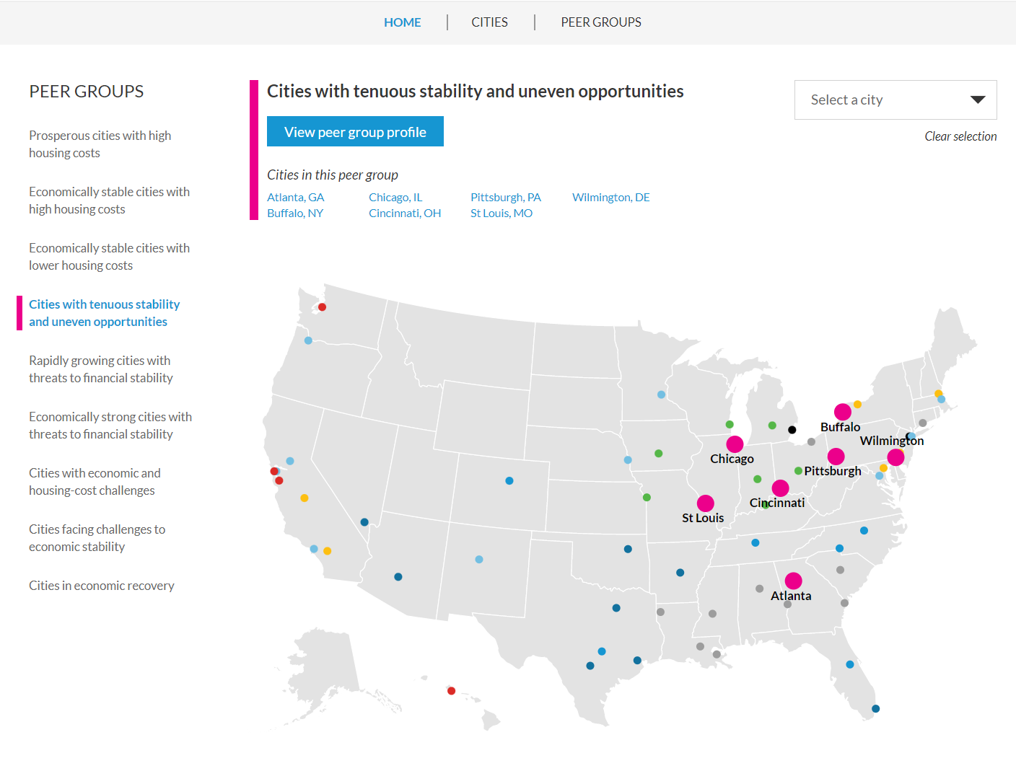
Financial Health is Important for your City
Notes:
The financial health of residents is linked to the financial health of cities. Financial insecurity can cost cities millions. ​
During economic crises, financially healthy residents can better weather the storm, help stabilize city finances, and contribute to economic recovery. ​

Slide 3
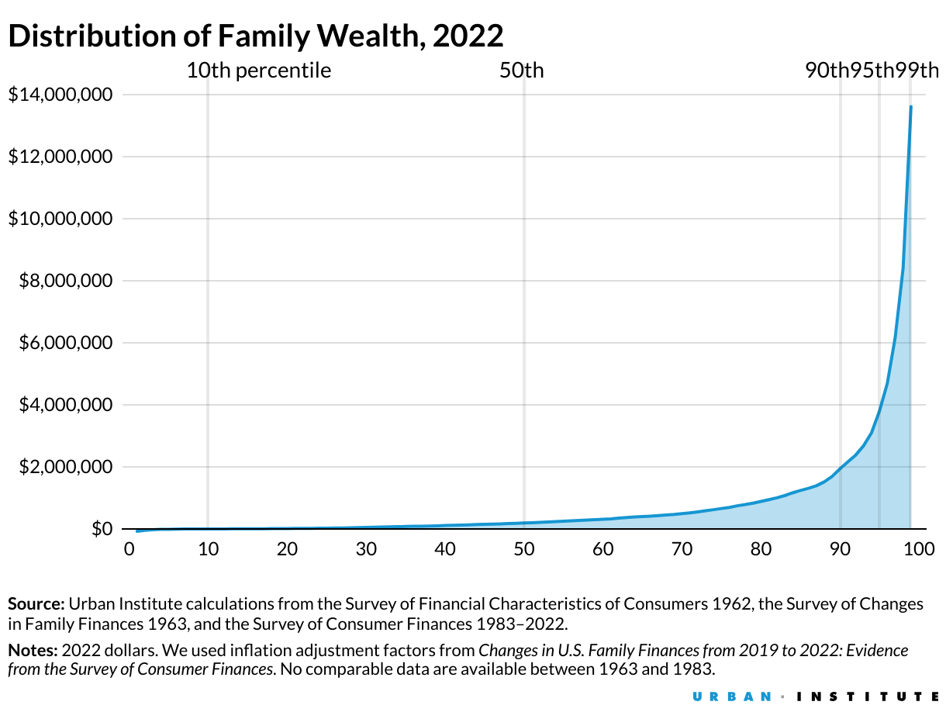
Wealth inequality is increasing and needs bold solutions
71X
Notes:
Between 1963 and 2022, wealth has increased for all income groups. Families in the bottom income group went from having debt to having wealth. Those in the middle nearly quadrupled their wealth. The wealthiest families saw their wealth increase more than sevenfold.
In 1963, the wealthiest families had 36 times the wealth of families in the middle of the wealth distribution. By 2022, they had 71 times the wealth of families in the middle.
Overall, wealth is increasing but so is inequality.
[Not talking points. Supplemental data points]
near the bottom of the wealth distribution (those at the 10th percentile) went from having $23 in debt to $450 in wealth.
Those in the middle (50th percentile) nearly quadrupled their wealth (from $50,598 to $192,700).
The wealthiest families—those wealthier than 99 percent of all families—saw their wealth increase more than sevenfold (from $1.8 million to $13.6 million).

Slide 4
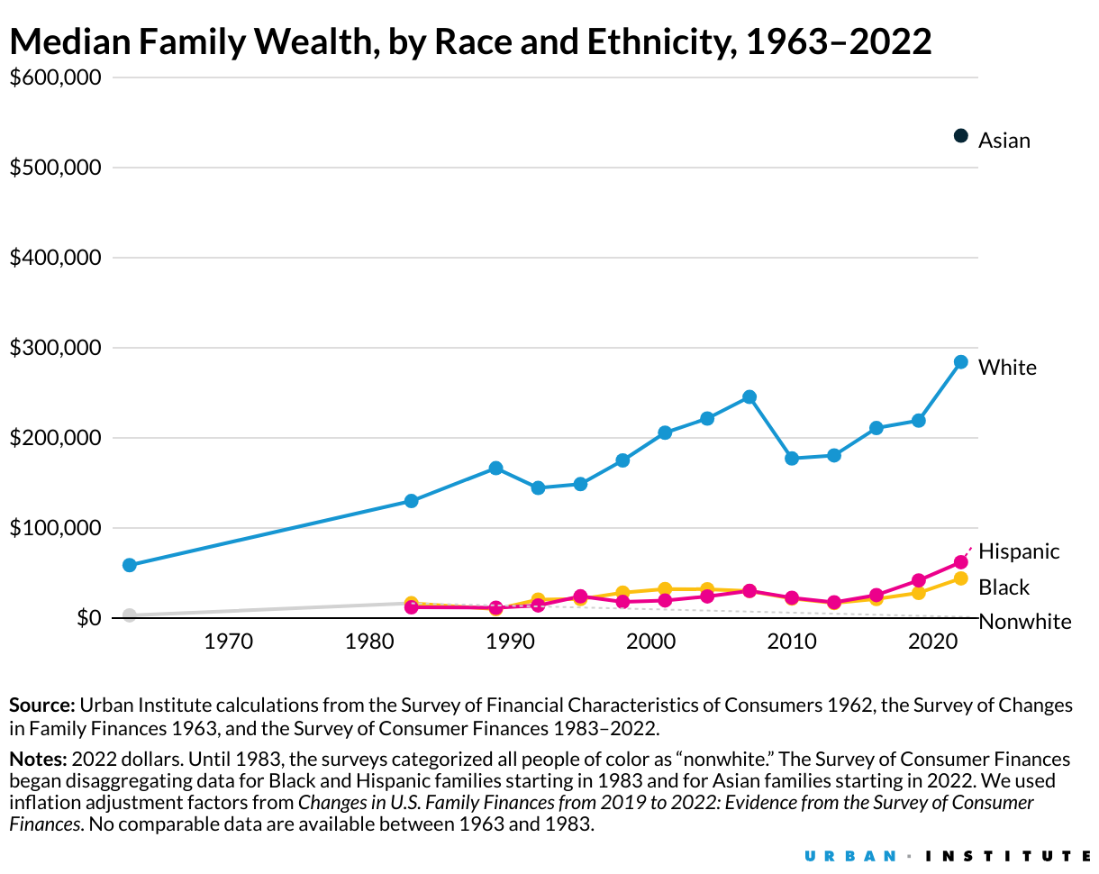
Wealth gaps by race and ethnicity are large
6X
Notes:
Over the past four decades, the difference in wealth held by white, Black, and Hispanic families has grown.
In 1983, the average wealth of white families was about $320,000 higher than the average wealth of Black and Hispanic families.
By 2022, white families’ average wealth was more than $1 million higher than that of Black and Hispanic families. Meaning, white families had six times the average wealth of Black families and Hispanic families.
[Not talking points, supplemental data points in case Qs arise in Q&A]: By 2022, white families’ average wealth were $1.4 million. Black families were $212,000 (exact $211,596). Hispanic families were $228,000 ($227,544). Asian families $1.8 million ($1,809,002)

Slide 5
Financial Health & Wealth Dashboard

Slide 6
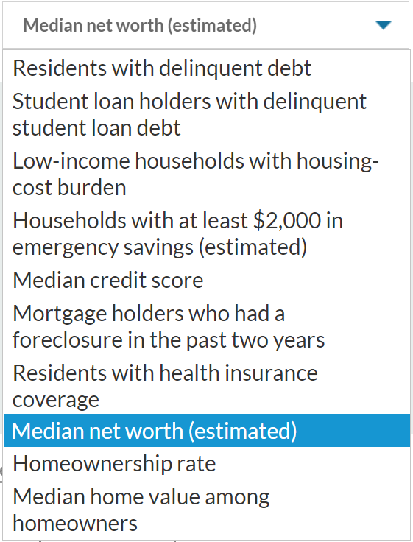
The Financial Health and Wealth Dashboard

Slide 7
Understanding Financial Health Metrics and Why They Matter
Credit Scores are a composite indicator of overall credit health. Having a subprime credit score can limit access to credit and increase the cost of debt. Scores range from 300 to 850; a score below 600 is subprime.
Delinquent Debt show signs of financial distress that can affect a household’s ability to meet basic needs. Delinquent debt appears on credit reports and can impact a resident’s ability to get hired, find housing, and access additional capital. Delinquent debt is debt that is 30, 60, or more days past due or in collections.
Emergency Savings (or liquid assets) offer families a cushion against economic disruptions. Without savings, residents are at greater risk for eviction, more likely to fall into spirals of debt, and less able to invest in wealth-building opportunities. Evidence suggests between $400 and $2,000 are needed for residents to weather short-term economic shocks.
Net Worth (total assets minus total debt) can indicate a household’s ability to build wealth and pursue opportunities for upward mobility, like starting a business, buying a home, investing in education or training, and transferring wealth to future generations. Without wealth, residents are less able to provide economic stability for their households and invest resources in their communities.

Slide 8
Financial Health Metrics We define financial health as a person’s ability to manage their daily finances, be resilient to economic shocks, and pursue opportunities for upward mobility.
Daily Finances​ | Economic Resilience​ | Upward Mobility​
Residents with delinquent debt​ Student loan holders with delinquent student loan debts​ Low-income households with housing-cost burden​ | Households with at least $2,000 in emergency savings (estimated)​ Median credit score​ Mortgage holders who had a foreclosure in the past two years​ Residents with health insurance coverage | Median net worth (estimated)​ Homeownership rate​ Median home value among homeowners​
Data Sources: American Community Survey (ACS), Survey of Income and Program Participation (SIPP), Credit Bureau Data

Slide 9
Financial Health Strategies City and community leaders from government, philanthropy, and practice can make a difference in residents’ financial lives
Daily Finances​ | Economic Resilience​ | Upward Mobility​
Help residents avoid and manage debt Improve access to financial institutions Ensure family-sustaining wages Help residents manage transportation or utility costs And more…. | Protect those at risk of eviction Help residents build credit safely Encourage savings Promote health insurance coverage Improve access to safety net programs And more… | Help resident build wealth and assets Promote homeownership & protect homeowners Resolve heirs’ property issues Support small business growth & recovery And more…

Slide 10
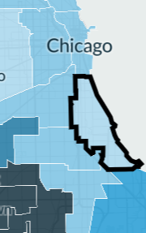
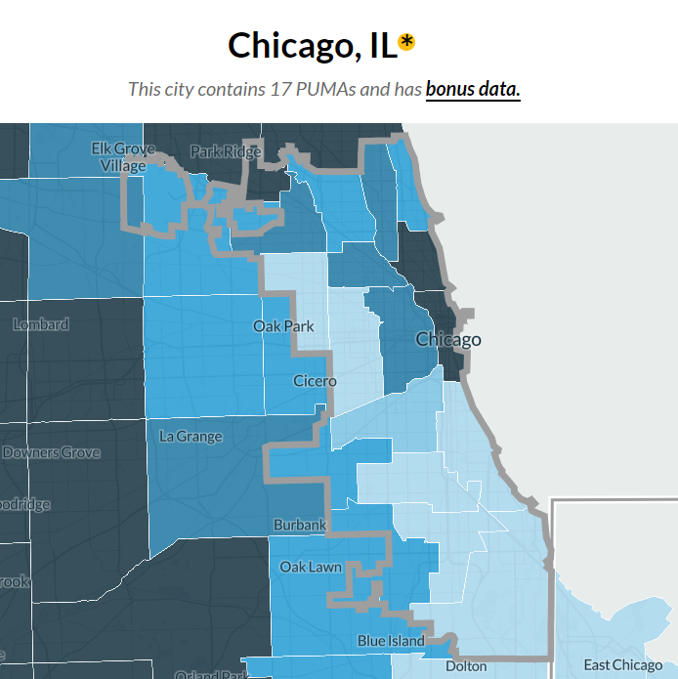
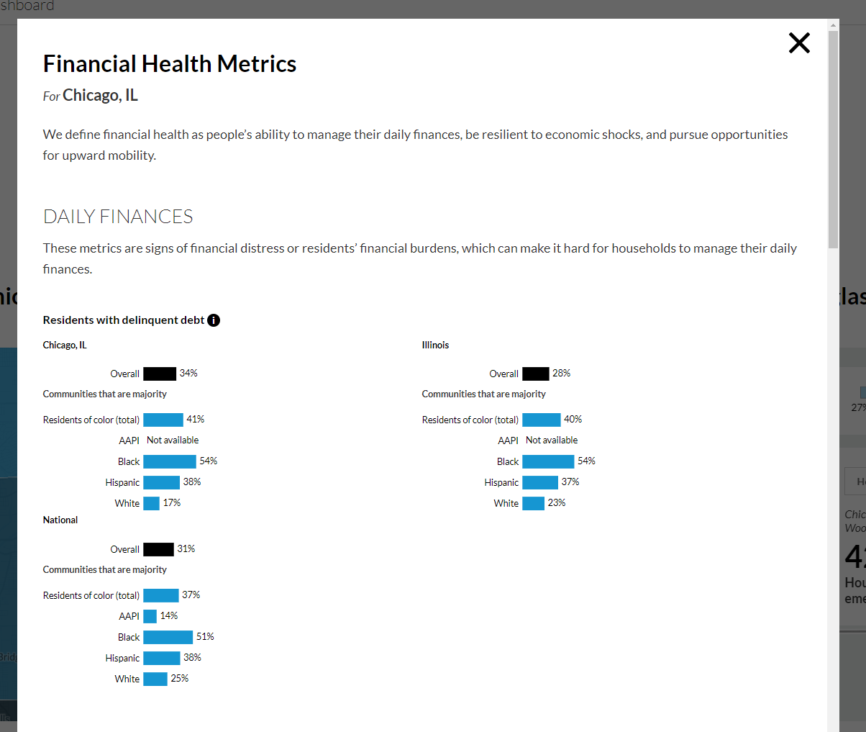
Selecting Your Data View: PUMA vs. City-Level Data
Enter a city or zip code and (1) select a PUMA on the map or (2) explore the "Bonus City Data"
PUMA View
City View
"Bonus City Data" Pop-Out
Notes:
Users can search their community by city or zip code. Once they’ve drilled down to the local level, the dashboard offers 2 functionalities to help cities answer questions about the financial health of residents.

Slide 11
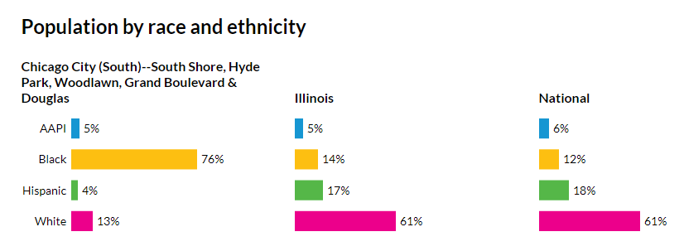
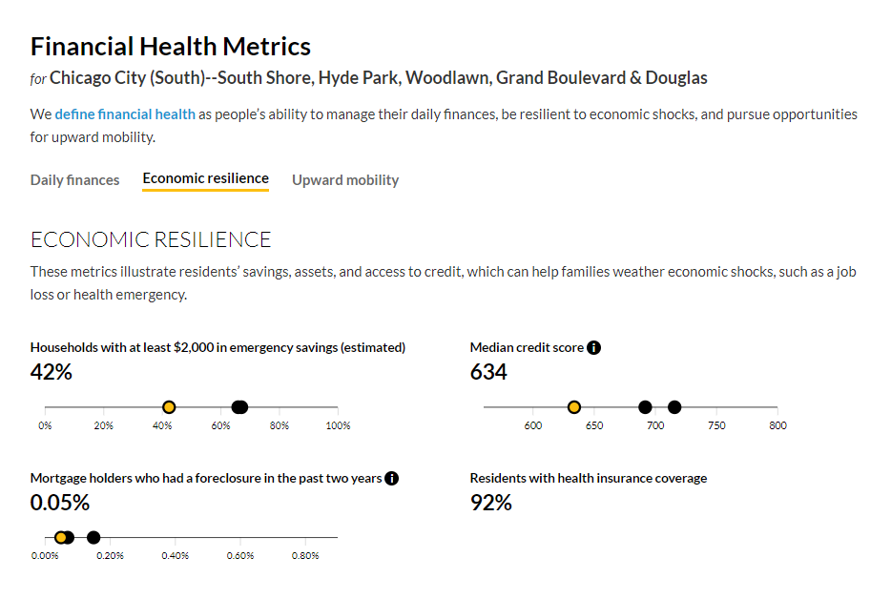
PUMA Level Data:
Demographic data for every PUMA
Data for all 10 metrics across daily finances, economic resilience, and upward mobility
Comparisons to state and national statistics
Notes:
The first functionality is to use the “PUMA view” to look at local area. PUMA is defined by the US Census Bureau as local areas containing more than 100,000 people. We have about 2,400 local regions, which cover the entire country. We can compare local-level data to the rest of the city, state, and country. This could allow users to prioritize what local areas need more specific supports.

Slide 12
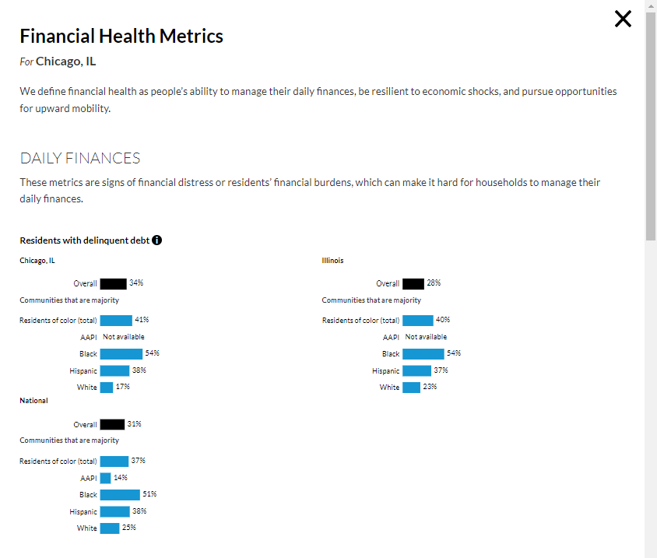
City-Level Data:
City-level data for 5 metrics, disaggregated by race/ethnicity
Comparisons to state and national data
Notes:
The second functionality is to explore the “bonus city data” to see city-level metrics disaggregated by race and ethnicity.
We’re going to take a deeper dive into some of these metrics by using the city of Louisville, KY as a case example. I should note that I am not an expert in this city, and can only share the data we have in the dashboard and demonstrate how this data can be a starting point for further conversations to
better understand the financial realities across their communities and identify potential strategies to support financial well-being and address racial disparities

Slide 13
Case Study: Louisville, KY

Slide 14
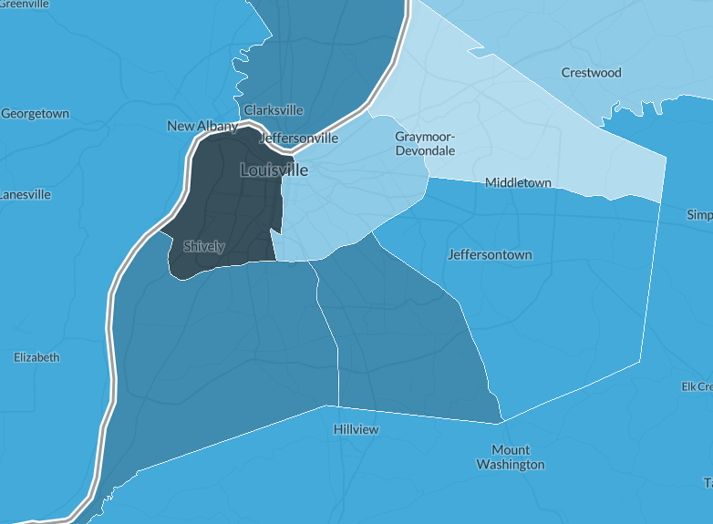
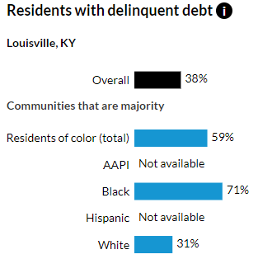
Residents in majority-Black neighborhoods are more likely to face the burden of debt
Case study: Louisville, KY
Residents living in majority-Black communities are nearly 2X more likely than residents living in majority-white communities to have delinquent debt.

Slide 15
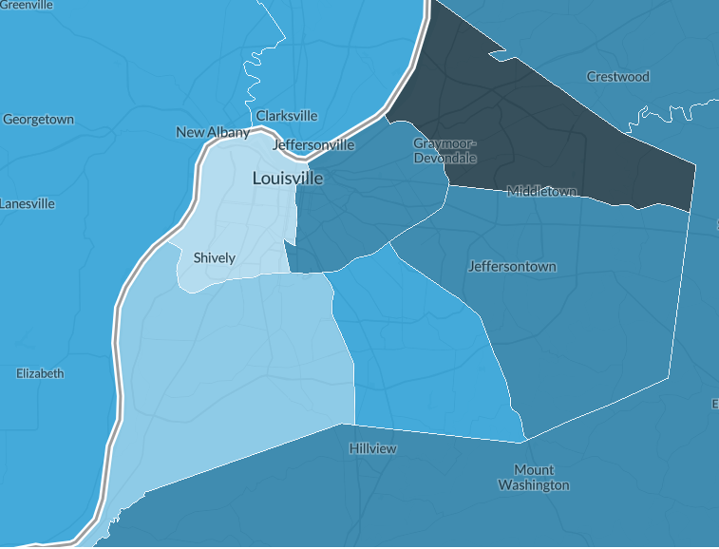
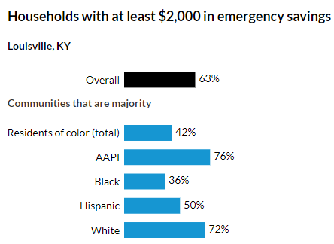
63 percent of Louisville residents have $2,000 in emergency savings to help buffer economic shocks
Case study: Louisville, KY
Clear racial and geographic disparities show majority white communities are 2X more likely than households in majority Black communities to have emergency savings.

Slide 16
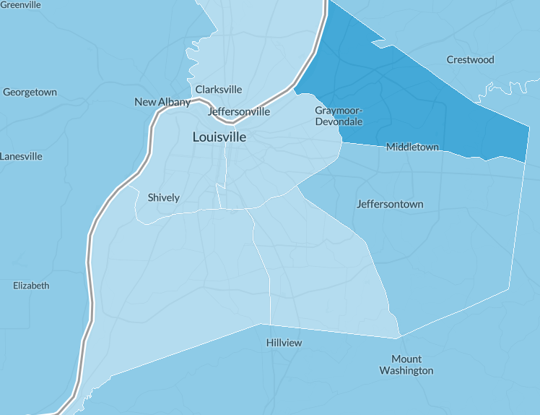
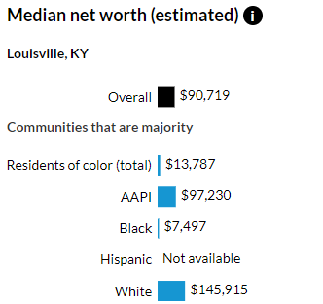
Wealth is concentrated in the eastern regions of the Louisville
Case study: Louisville, KY
Households in majority white communities have an estimated 19.5X more wealth than households in majority Black communities.

Slide 17
Case Study: Columbus, OH

Slide 18
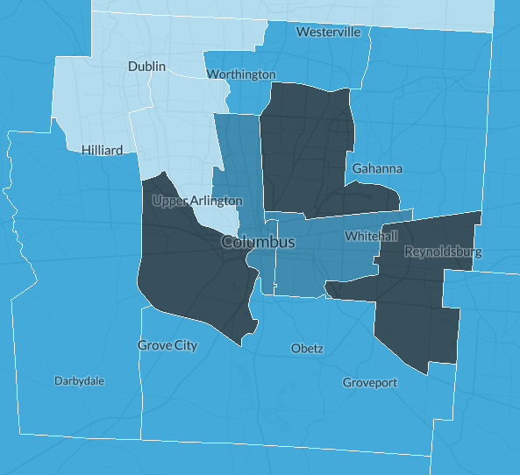
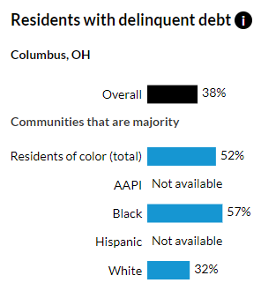
Residents in majority-Black neighborhoods are more likely to face the burden of debt
Findings: Columbus
Residents living in majority-Black communities are nearly 2X more likely than residents living in majority-white communities to have delinquent debt.

Slide 19
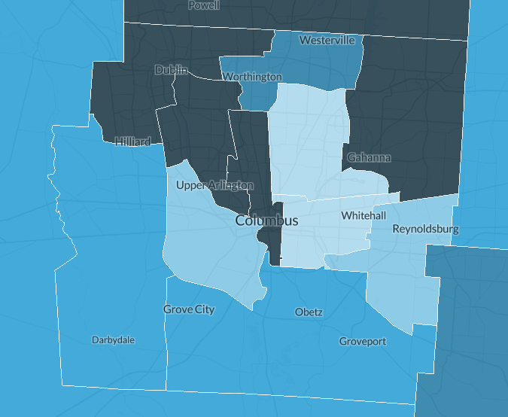
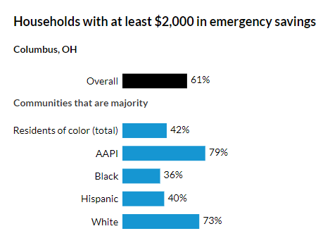
61 percent of Columbus residents have $2,000 in emergency savings to help buffer economic shocks
Findings: Columbus
But there are clear racial and geographic disparities in emergency savings as households in majority white communities are 2X more likely than households in majority Black communities to have at least $2,000 in savings.

Slide 20
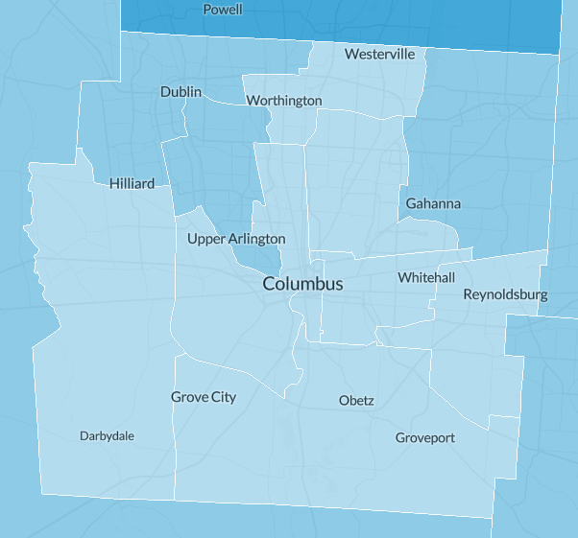
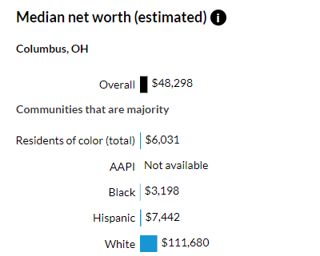
Wealth is concentrated in the northwest and far northeast regions of the Columbus
Findings: Columbus
Households in majority white communities have an estimated 35X more wealth than households in majority Black communities.

Slide 21
Leveraging local data insights to inform strategies that can address the racial wealth gap

Slide 22
Practitioners can use the data and strategies to:
introduction
Local government: integrate and expand targeted financial and savings interventions into existing policies and programs.
Community advocates and service providers: advocate for new and improve targeting of existing programs and services related to financial coaching, empowerment, and asset building.
Philanthropy and impact investors: inform aligned grantmaking strategies and community investments that improve household and neighborhood level financial health.
Financial institutions: introduce tailored financial products and services that can enhance customers’ financial health and address racial disparities in lending and credit access.

Slide 23
Appendix
Notes:
We know there is much more context, data, and lived experiences that local residents and government know about the city and these local areas.

Slide 24
Guiding Questions: Using Data to Inform Strategies and Solutions
Next Steps
Strategy Deep Dive:
How does financial health and wealth vary by race/ethnicity and geography in our city?
What are “north star” indicators of systemic change for our community?
Solutions Deep Dive:
How do current programs/policies align with our residents' financial needs?
How can new programs move the needle for indicators of resident financial health?
What other evidence-based strategies can we consider to further support financial health of residents based on the specific needs in our community?

Slide 25
Exploratory Activity
Assignment
Step 1: Search for a ZipCode to identify a local area of interest in your work. Scroll down to review data on that PUMA. Identify one metric from each bucket of financial health that is of interest or relevant to your work.
What data surprised you? Confirmed what you expected? What data are particularly relevant to your work?
Step 2: Scroll back up to the map to view your selected area within the context of a broader region. Using the dropdown toggle between the different metrics.
What trends do you notice in the map? How does the selected PUMA compare to surrounding areas across or outside of your city?
Step 3: Based on the metrics you selected in step 1, scroll down to the strategies section. Explore strategies across the 3 buckets of financial health that can address the metric(s) you selected.
How do these strategies align with the mobility work you and your partners are leading in your local regions?

Slide 26
Additional Resources
Financial Health & Wealth Dashboard: Strategies for Local Leaders
Financial Health & Wealth Dashboard: Data catalogue
Financial Health & Wealth Dashboard: Technical Appendix
Washington, DC, Has Glaring Financial Health Inequities. So Do Most American Cities
Thriving Residents, Thriving Cities: Family Financial Security Matter for Cities
Cost of Eviction and Unpaid Bills of Financially Insecure Families for City Budgets
Debt in America: An Interactive Map
Credit Health during the COVID-19 Pandemic
Developing Solutions: Strategies to Improve Resident Financial Health and Propel Inclusive Growth
How Policymakers Can Ensure the COVID-19 Pandemic Doesn’t Widen the Racial Wealth Gap

