Slide 1
Using Data to Guide Strategies for Closing the Racial Wealth Gap
NNIP Conference
Detroit, 2024
Lamar Gardere, Executive Director
lamarg@datacenterresearch.org

Slide 2
About Us
The Data Center is the most trusted resource for data about greater New Orleans and Southeast Louisiana. Founded in 1997, we provide fully independent research and analysis to offer a comprehensive look at issues that matter most to our region. Our work makes available a tool box of fact–driven, well–researched data that moves beyond anecdotal experiences to uncover root causes for our region’s challenges. With a mission of democratizing data, The Data Center has, and continues to be, an objective partner in bringing reliable, thoroughly researched data to conversations about building a more prosperous, inclusive, and sustainable region.
Notes:
Wanted to acknowledge our staff: Allison Plyer, Rachel Weinstein, Keisha Smith, Jenna Losh, Erica Amrine, Robby Habans, Dabne Whitemore.

Slide 3
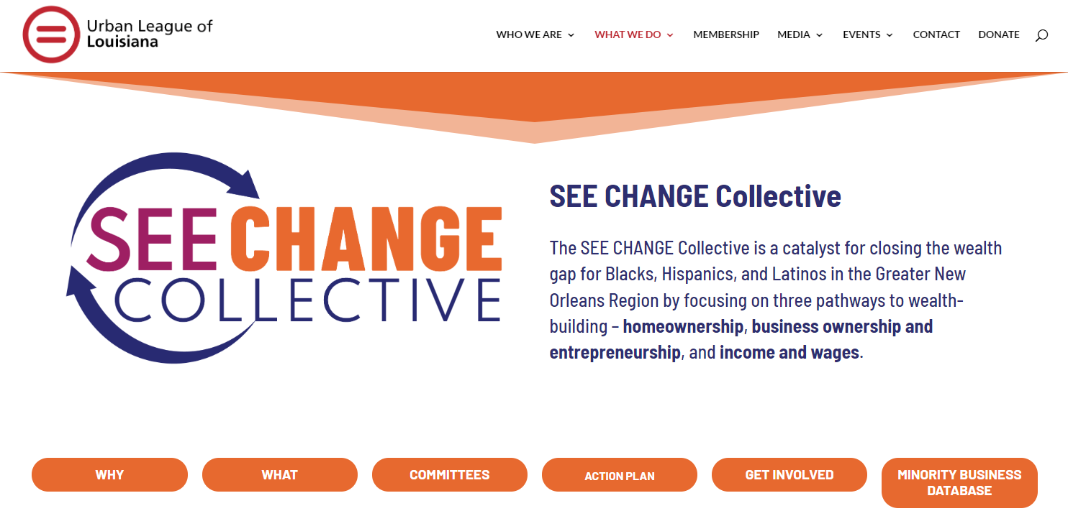
On-the-ground partnership motivated The Data Center’s work.

Slide 4
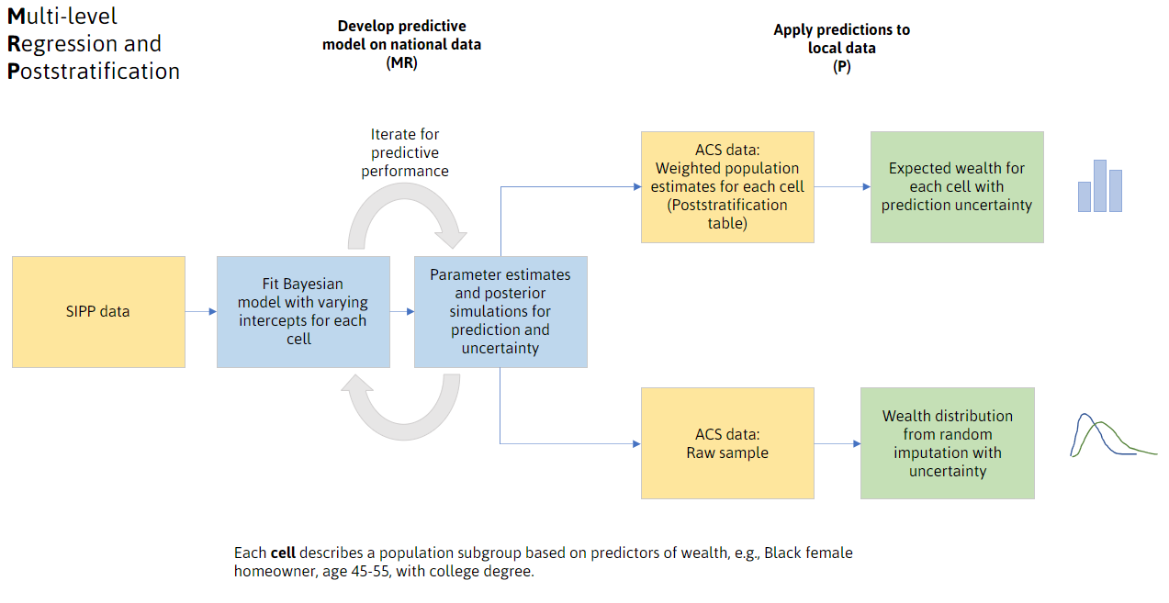
The Data Center applied statistical methods from multiple disciplines to publicly available data to develop reliable, accurate estimates of local wealth.
Wealth Calculations

Slide 5
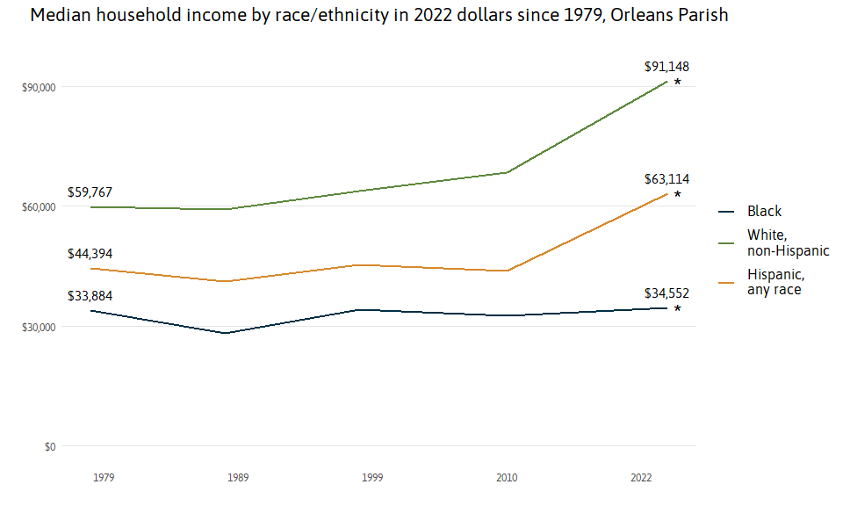
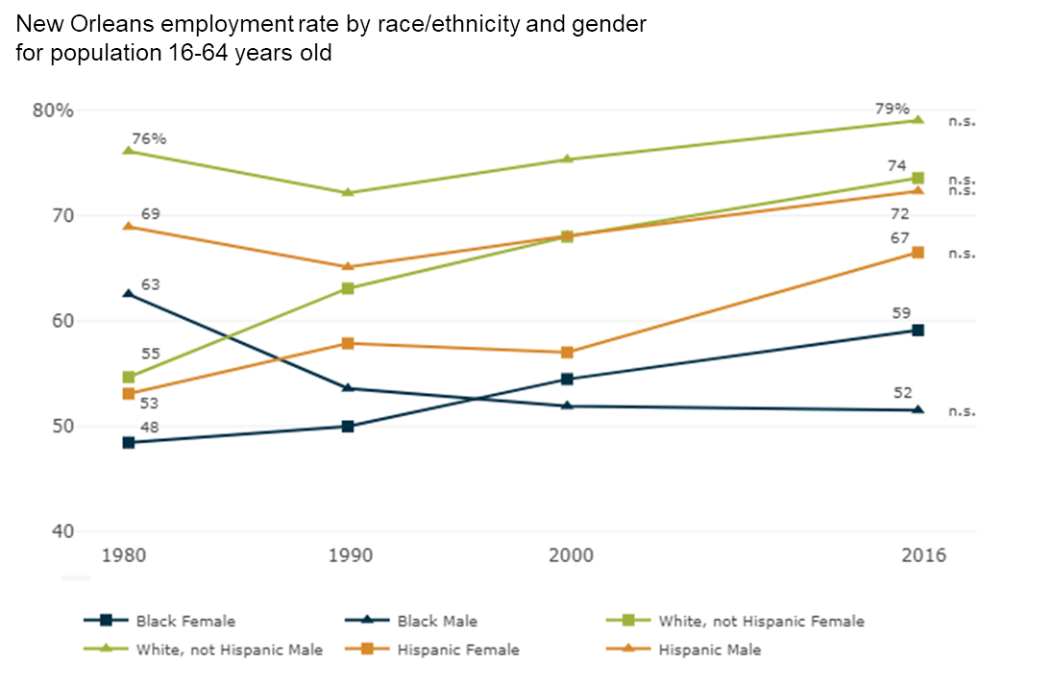
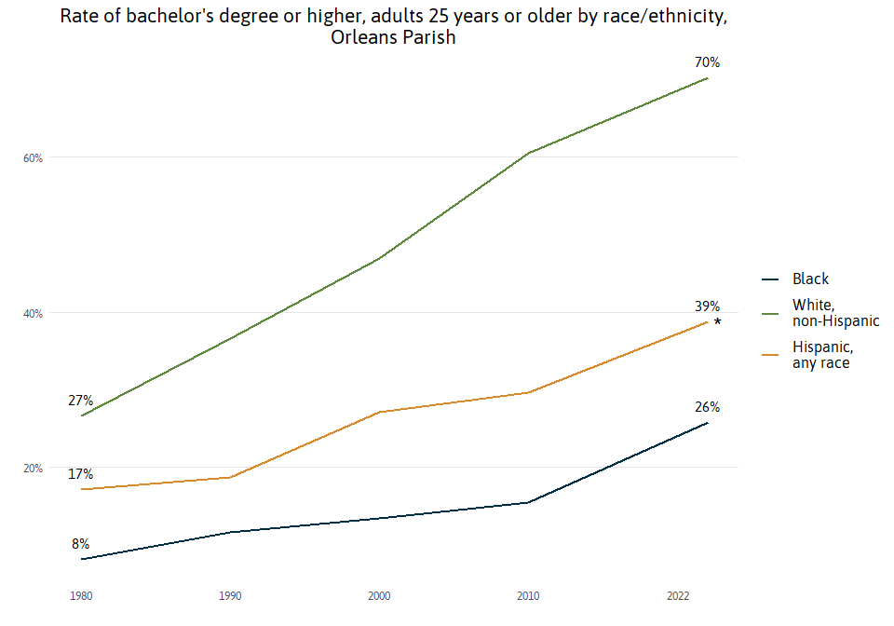
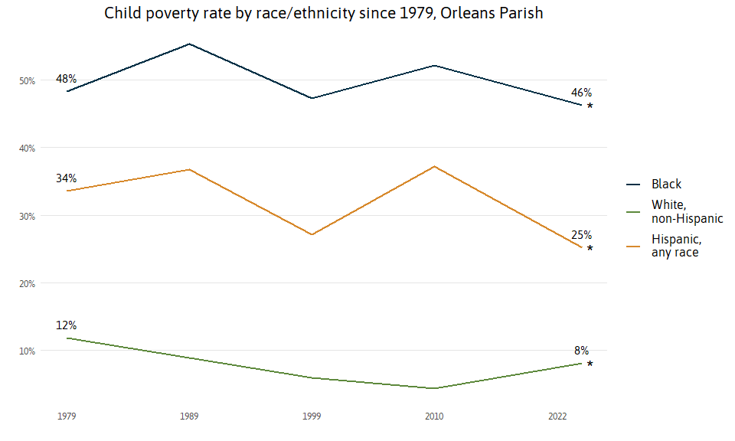
Measures of income, education, homeownership, etc act as snapshots in time describing the condition of our population. Unfortunately, measuring how all of this contributes to overall success is hard, but wealth condenses these challenges into a single calculation. Wealth is a powerful way to contextualize the problems communities face and clears the path for data to better contribute to problem solving.

Slide 6
This work may be cool, but what does it tell us that we don’t already know? How can it inform our work?

Slide 7
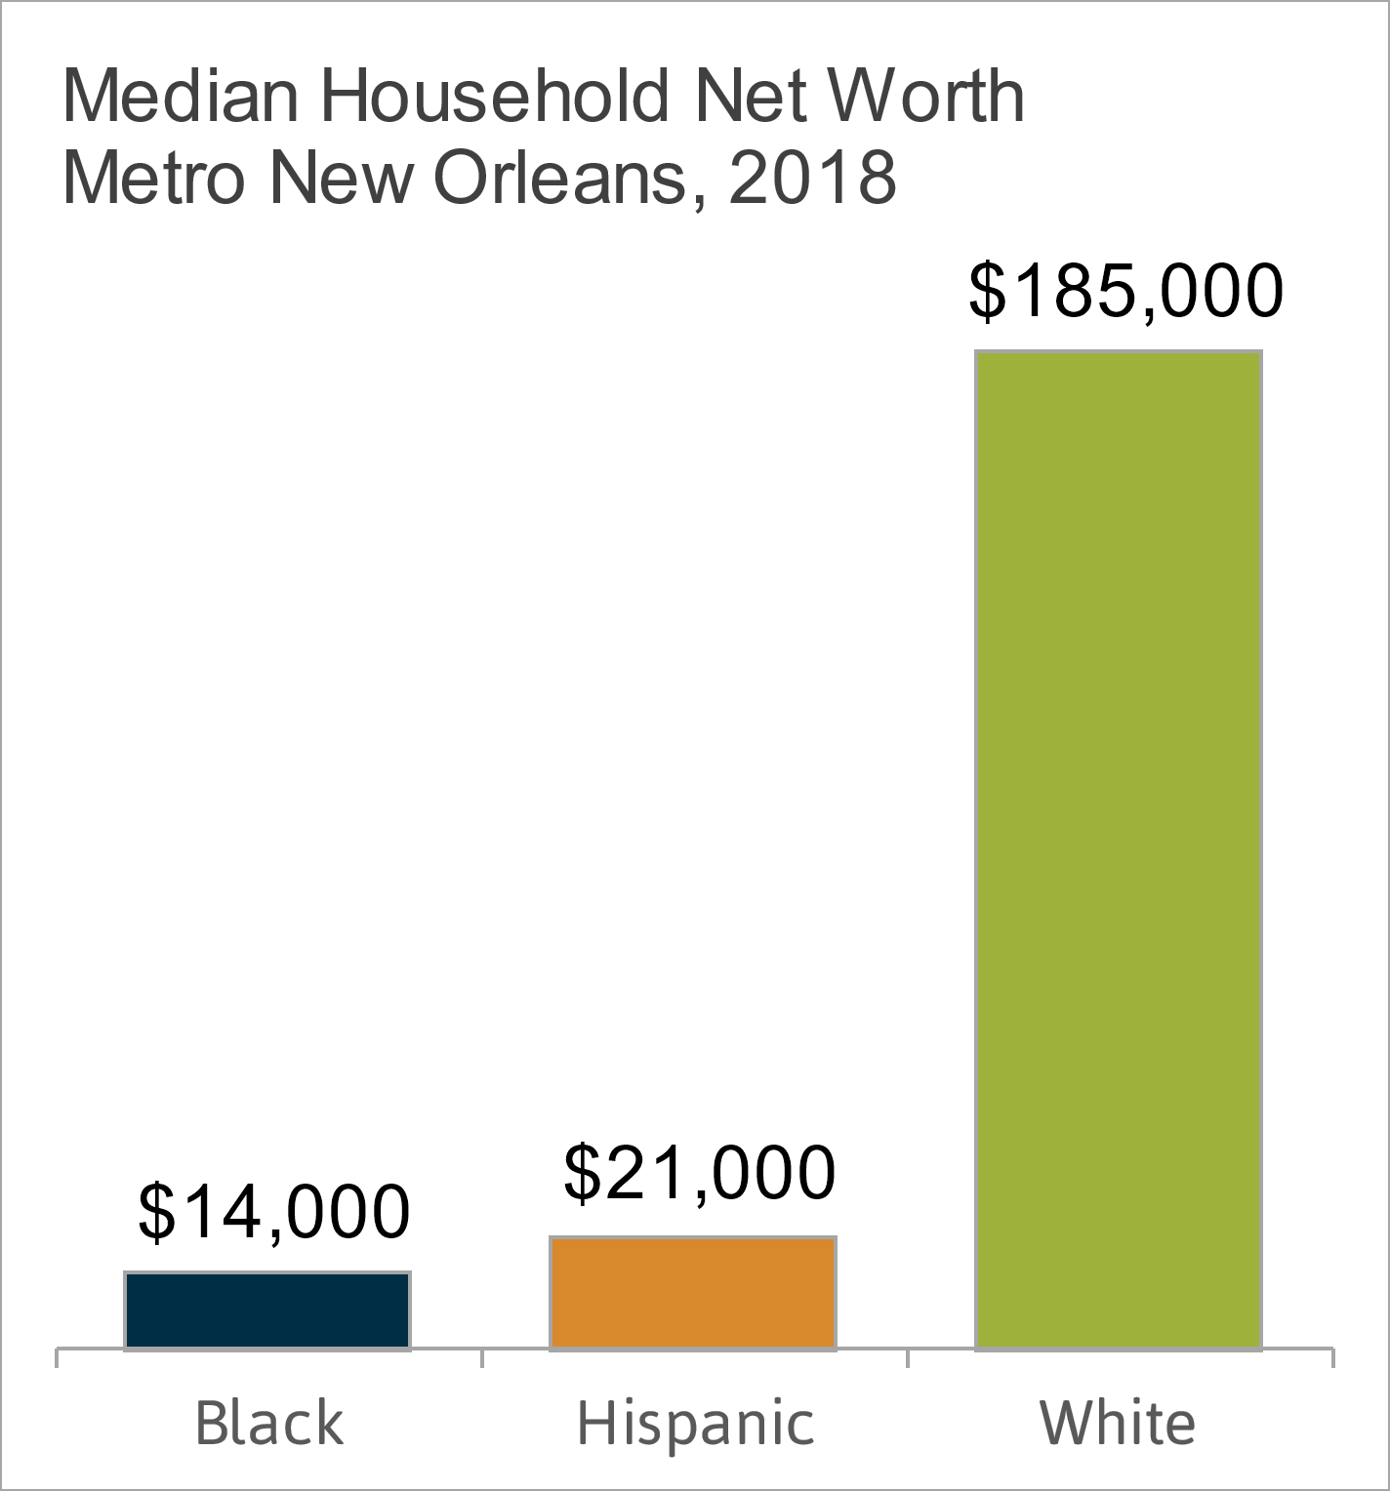
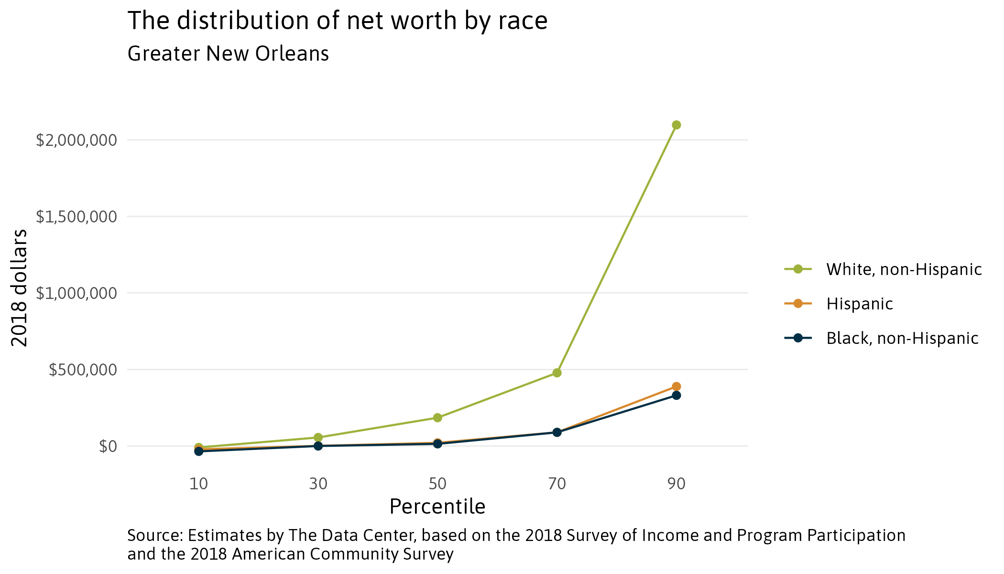
White households in metro New Orleans are estimated to have more than 13x the median net worth of Black households and nearly 9x the median net worth of Hispanic households.
Notes:
Source: Estimates by The Data Center, based on the 2018 Survey of Income and Program Participation and the 2018 American Community Survey
This graphic illustrates why I don’t call it the racial wealth gap. Wealth disparities transcend race though are still well predicted by race. The lower third of the wealth distribution looks the same regardless of race, though we will see that some of that has to do with age.

Slide 8
It provides more specifics on the problem, suggesting how it should be solved. In this case, the data suggests that wealth disparities work can and should be on behalf of all people since there is little racial disparity at the low end of the distribution. In New Orleans this suggests interventions like raising the minimum wage, fixing racial disparities in “good” jobs and in small business revenues – all things addressed by the SEE Change Collective.
Very little disparity at the lower third of the distribution.
Relatively affluent Black and Hispanic people only have as much wealth as the typical White person.
Notes:
Source: Estimates by The Data Center, based on the 2018 Survey of Income and Program Participation and the 2018 American Community Survey
This graphic illustrates why I don’t call it the racial wealth gap. Wealth disparities transcend race though are still well predicted by race. The lower third of the wealth distribution looks the same regardless of race, though we will see that some of that has to do with age.

Slide 9
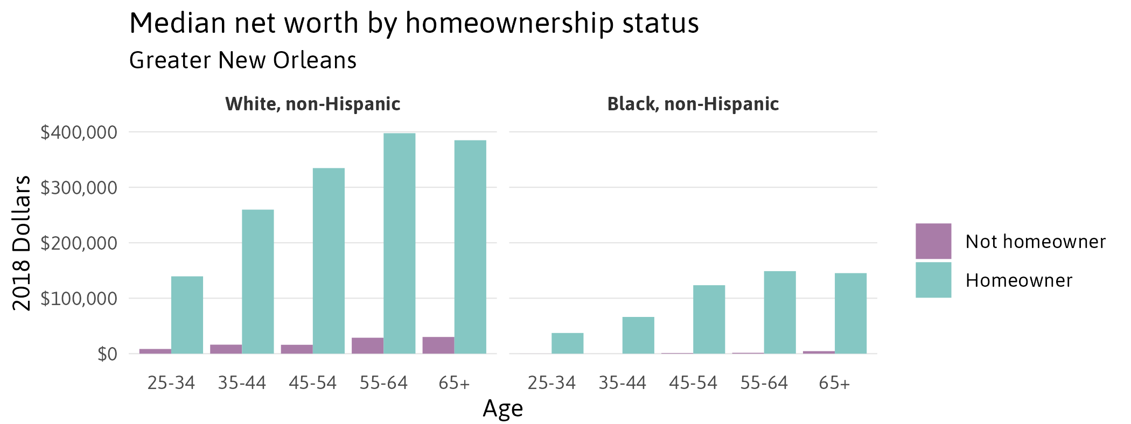
Black homeowners have far more wealth than Black non-homeowner households but also far less than White homeowner households. In general, non-homeowners struggle to build wealth. Not owning a home does not mean you won’t accumulate wealth, but it may be a side effect of other economic difficulties.

Slide 10
The SEE Change Collective includes homeownership as one of its key pillars for closing the racial wealth gap with programs that offer soft-seconds, advocate for alternative formulas for measuring credit, down-payment assistance, and first-time home-buyers education, but also supporting anti-displacement efforts and working to reform the appraiser network to produce fairer home valuation. In New Orleans, this also means reforming succession processes and controlling insurance costs. Innovative solutions like collective real estate ownership should aim to deliver the same wealth building opportunities that homeownership provides.

Slide 11
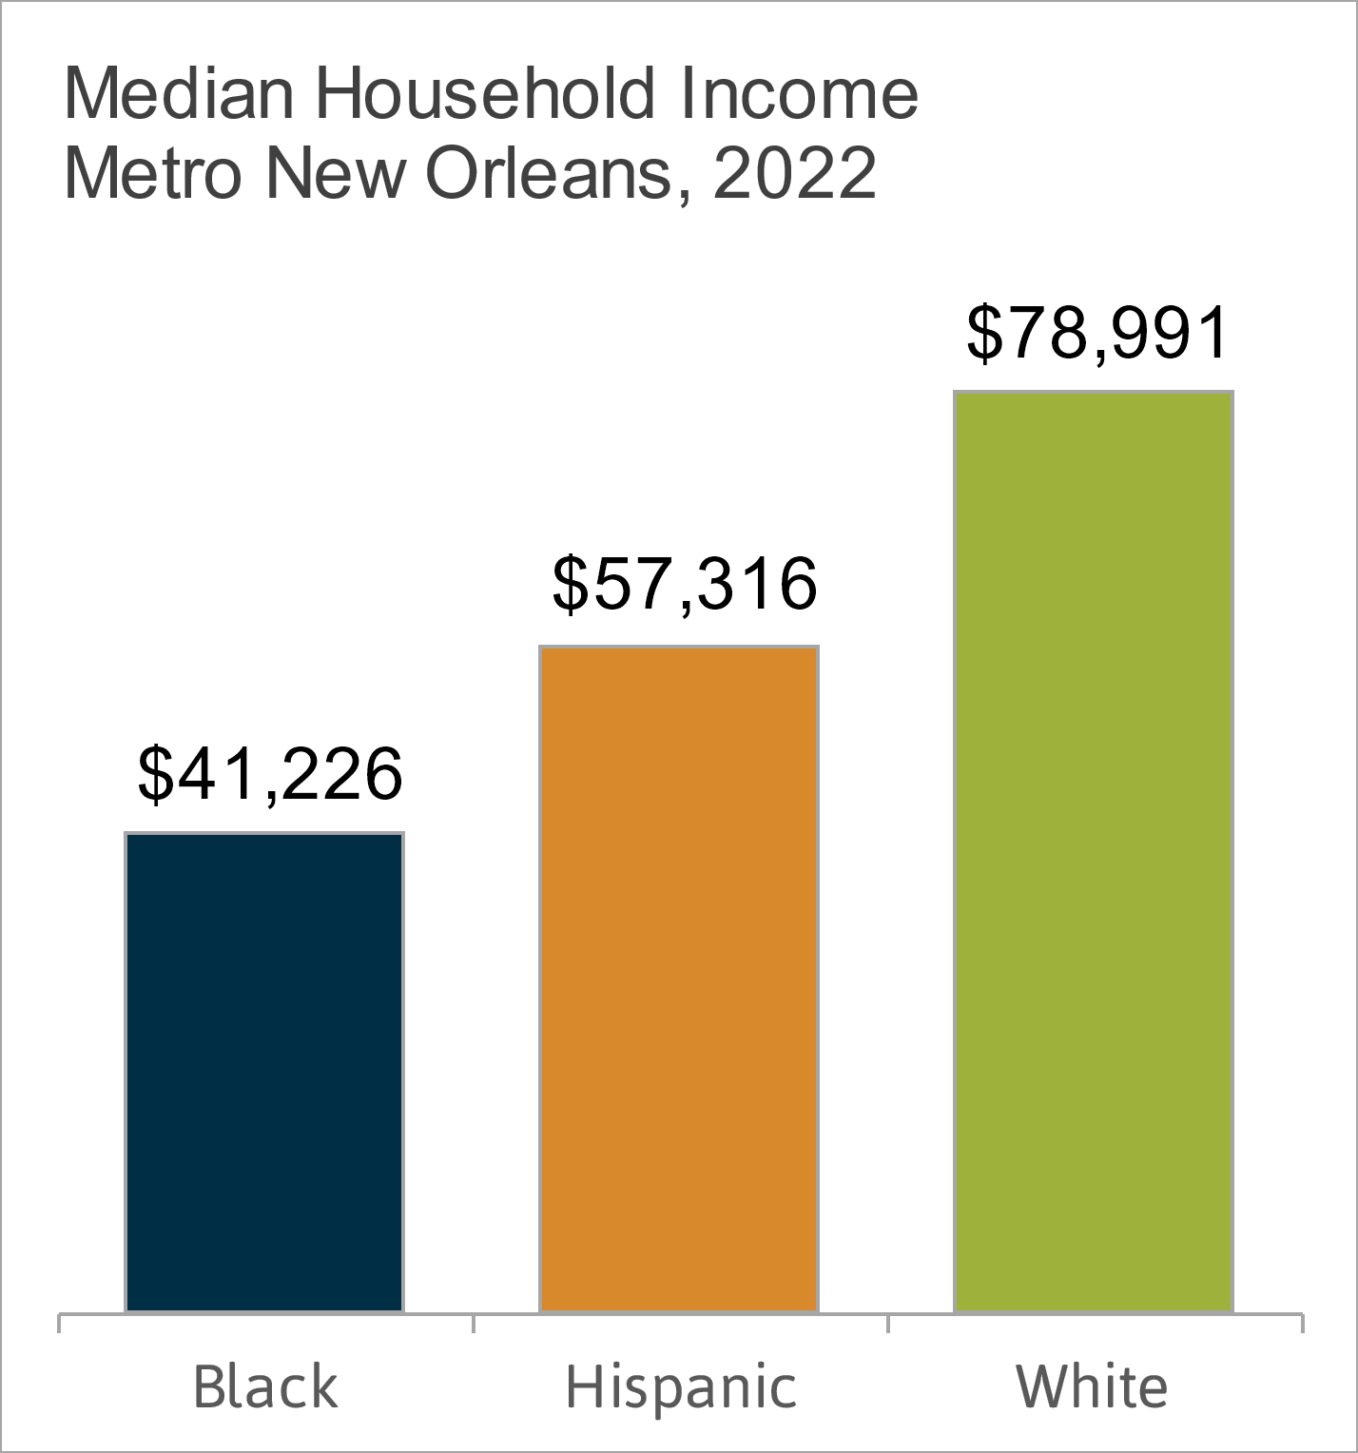
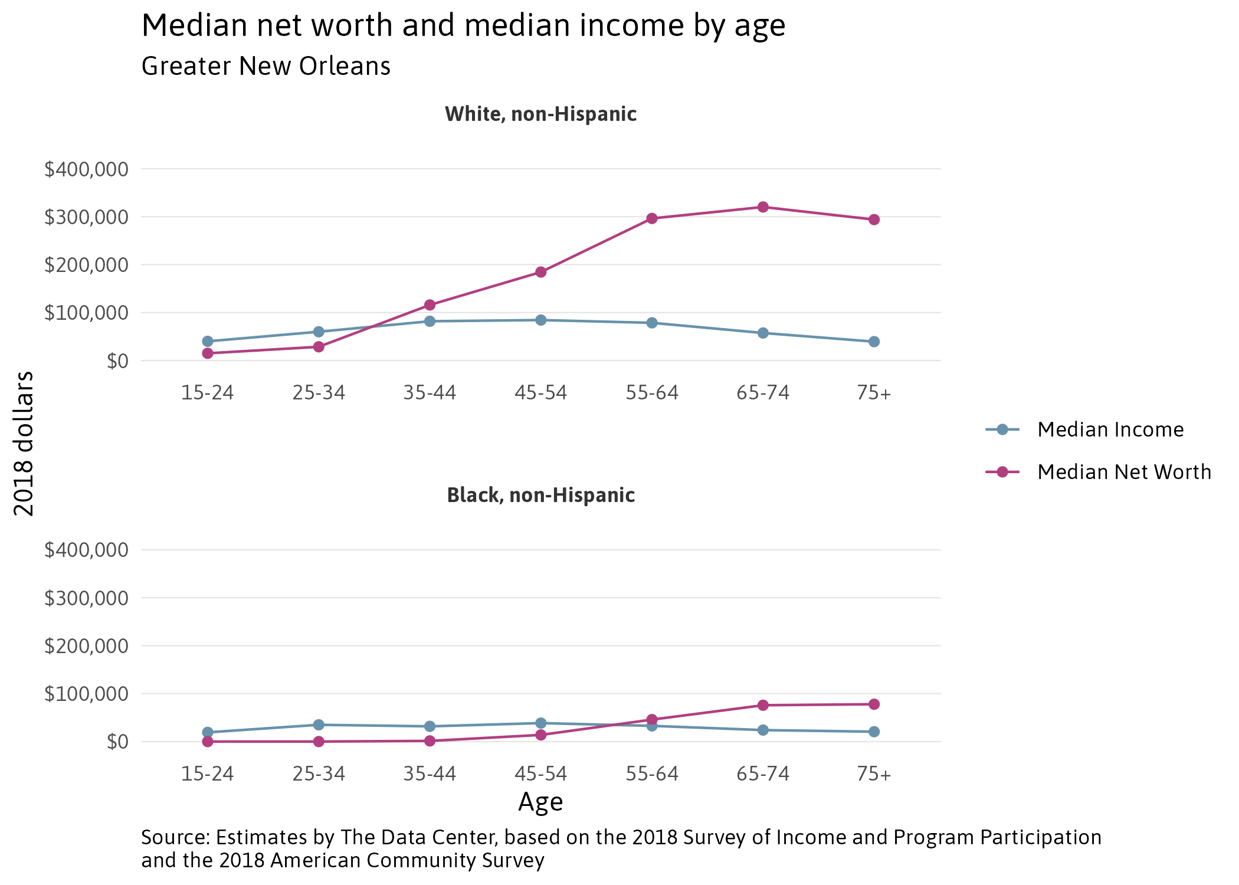
Wealth generally accumulates with age. Median net worth for Black households in the New Orleans metro peaks at just under $100k after age 65, but median net worth for White households surpasses that peak after just 35 years of age, peaking above $300k.
Notes:
Source: Estimates by The Data Center, based on the 2018 Survey of Income and Program Participation and the 2018 American Community Survey

Slide 12
Given the data, Urban League can more effectively close the wealth gap by targeting their homeownership programs at young people so their assets and therefore wealth grows over the course of life. New Orleans’ data also suggests young people of color should establish retirement accounts and invest in stocks and mutual funds early in life.
Notes:
Source: Estimates by The Data Center, based on the 2018 Survey of Income and Program Participation and the 2018 American Community Survey

Slide 13
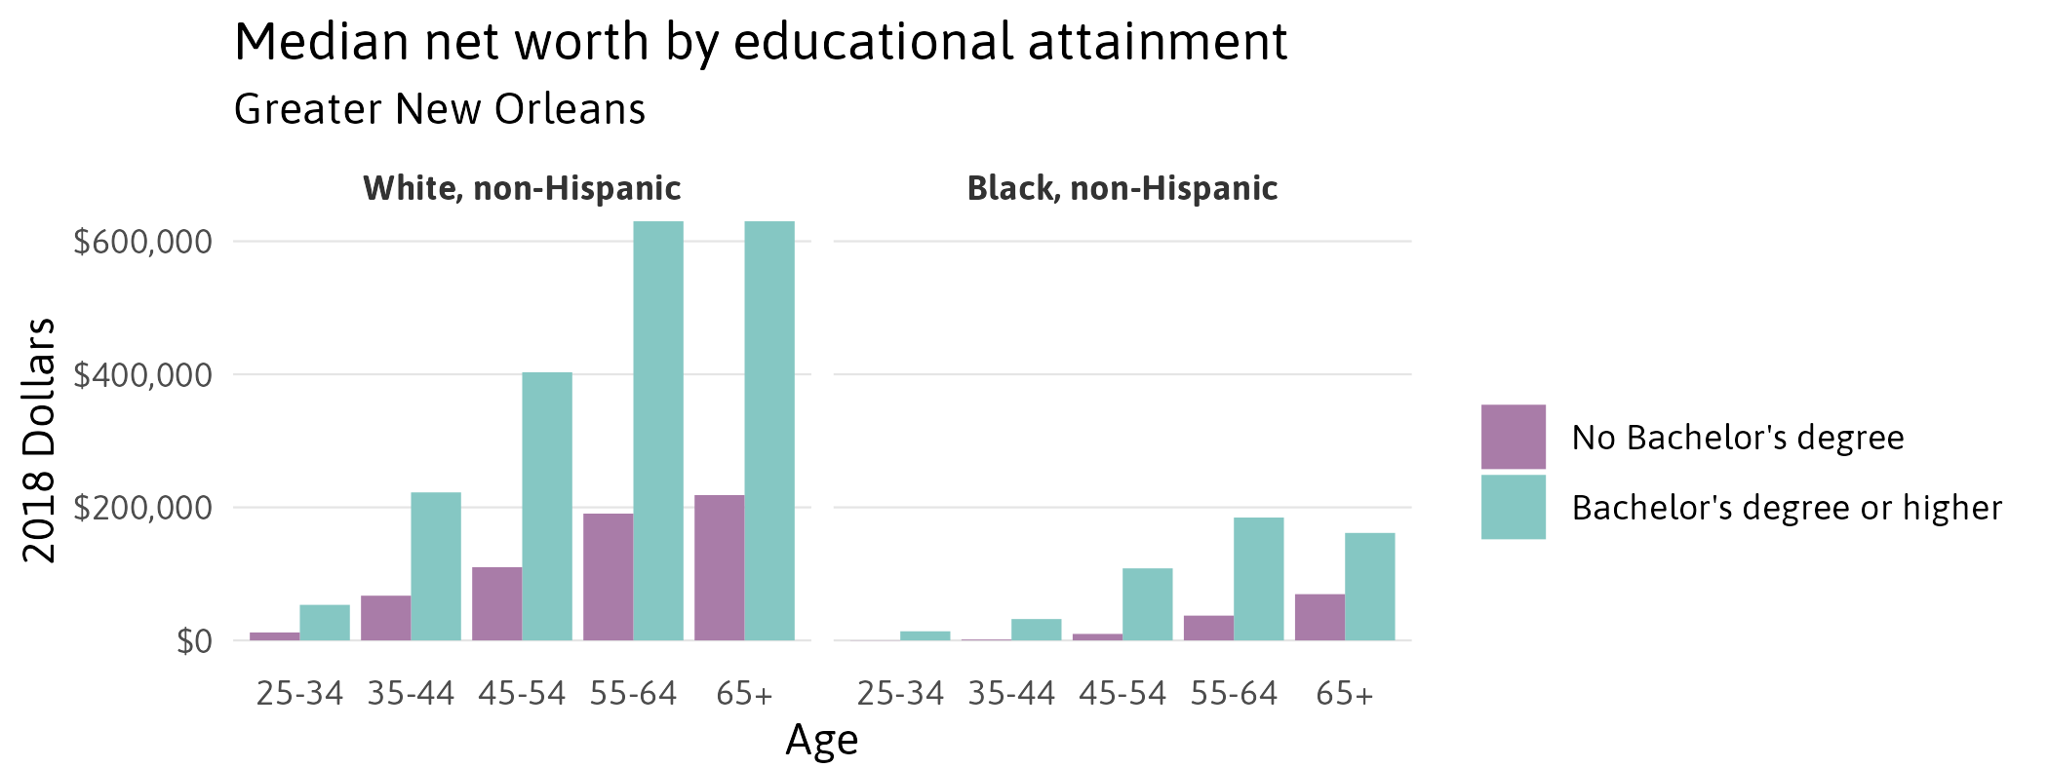
College graduates tend to be wealthier, but wealth among Black college graduates in Greater New Orleans is comparable to that of White householders with no college degree.
Notes:
Source: Estimates by The Data Center, based on the 2018 Survey of Income and Program Participation and the 2018 American Community Survey

Slide 14
Because wealth captures past inequities as well, the data can make clear to skeptical audiences that issues are not solely due to socio-economic or just a matter of individual effort. This improves the case for systems change.
Notes:
Source: Estimates by The Data Center, based on the 2018 Survey of Income and Program Participation and the 2018 American Community Survey

Slide 15
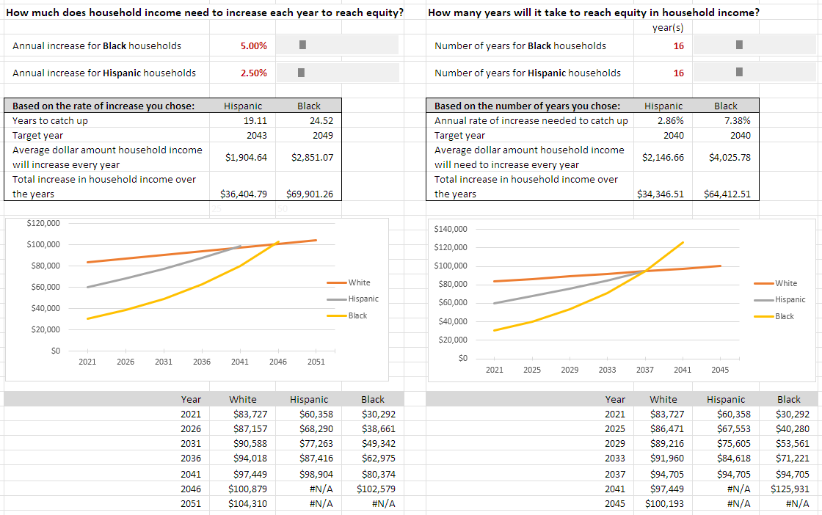
Leveraging the flexibility of our methods, policymakers can test the efficacy of their solutions, nonprofits and philanthropy can measure their impact, advocates and other leaders can understand the scale of impact needed to eliminate disparities.

Slide 16
Example: Milwaukee has an initiative to grow its population to 1 million people, but growth can be a mixed bag for vulnerable populations. Use the summative power of wealth and the breath of its inputs to ensure growth is benefitting everyone and not widening disparities.

Slide 17
Using wealth data as an effective tool for change
Data-based and systems-oriented solutions with a regional focus such as Urban League of Louisiana’s SEE CHANGE Collective will be necessary
Ex:
Changing apprenticeship rules for appraisers to facilitate an increase in appraisers of color
Change the way credit score are calculated or how banks make decisions on credit
Change business license registration and renewal forms to create data on minority owned businesses
Because both returns from wealth and barriers to economic mobility are compounding in nature, there is no single “fix” for the racial wealth gap – at least short of a dramatic shift in federal policies toward progressive taxation or redress for racial injustices.
Considering the age dynamics of wealth, helping young adults get on the ramp to accruing and keeping assets may reduce disparities that widen later in adulthood.
Research shows that there remains a strong link between the racial income gap and the persistence of the racial wealth gap, underscoring the importance of improving employment rates and expanding the number of “good” jobs with family sustaining wages.
Scale is important. Current efforts are good but not large enough.
Ex:
Workforce programs need to scale regionally to meet the scale of the challenge
Support wealth-building for existing homeowners, first-time home buyers, and renters

