Slide 1
NNIP Data Inventory & SNIP Score Update
ROB PITINGOLO
OCTOBER 13, 2017
Notes:
This is the 3rd time I’m presenting on this. Happy to report some improvements in the overall results.

Slide 2
Local data is central to the NNIP mission
Local data should be…
Small Geography Tract, Block Grp, Zip, Parcel
Recurring & Up-to-Date
2
Notes:
Before we get into results…
Local data is central to NNIP.
We care about data that is at small geographies and regularly updated.
NNIP partners agree to collect data:
across topics since problems and solutions rarely fall within silos
across time to reduce effort/costs of acquisition and processing over time, to look at trends, and to be responsive to quick requests
at the neighborhood level – because we know issues are not the same across the city

Slide 3
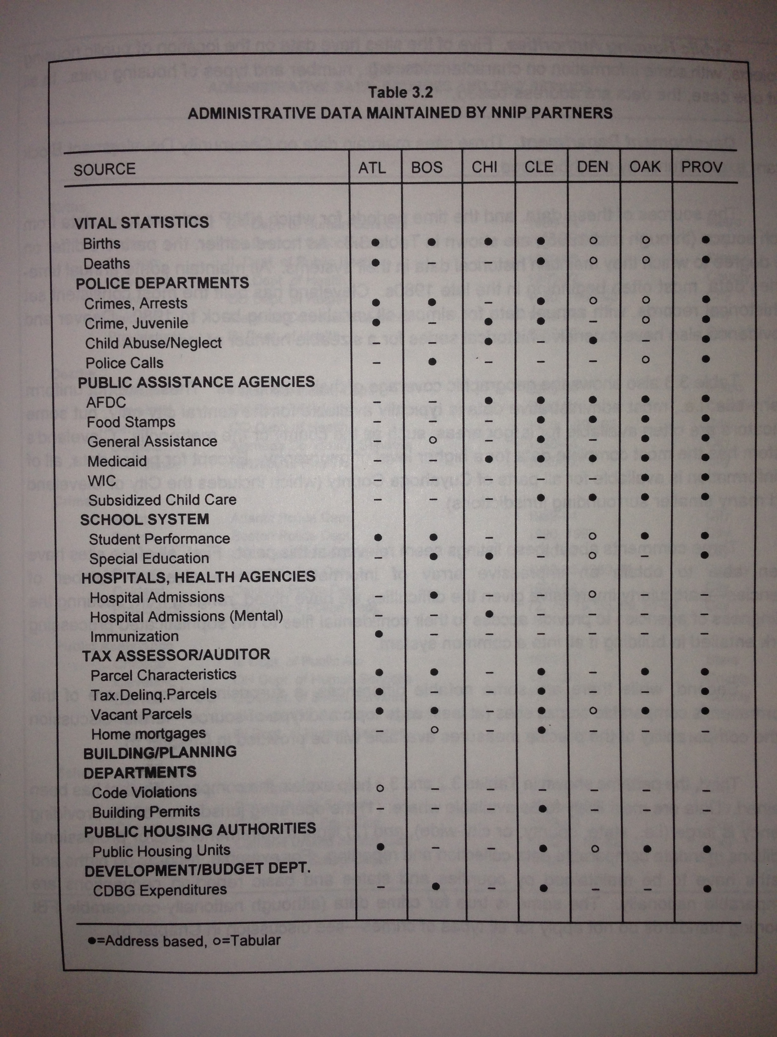
What is the Data Inventory?
First published1996 →
Geography & coverage level
Migrated to NNIP website in 2015
Suggestions for added data sources welcome
Notes:
Data inventory goes back almost 20 years.
Covers the most common types of data, but not everything.
Example suggestion: policing data

Slide 4
Value of the Data Inventory
Self-assessment for partners
Improve the network
Identify cross-site opportunities
Health
Vital Stats
Crime
Housing

Slide 5
Thank you partners for updating your inventories on time!
Atlanta
Austin
Baltimore
Charlotte
Cleveland
Columbus
Dallas
Denver
Detroit
Houston
Indianapolis
Kansas City
Los Angeles
Miami
Milwaukee
Minneapolis
New Haven
New York
Oakland
Philadelphia
Pinellas
Pittsburgh
Providence
San Antonio
Seattle
St. Louis
Washington, DC
5
Notes:
Thank you to all the partners who updated on-time!
Acknowledge that some of the scores aren’t based on up-to-date inventories.

Slide 6
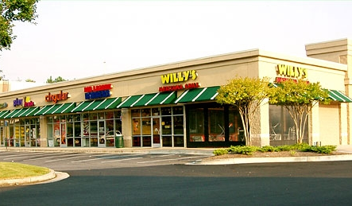
What is SNIP?
Small-geography Neighborhood Indicator Performance (SNIP) Components:
Vital Stats
Pt1 Crime
Distressed Property
Child Health
School Enrollment
Other Health
Property Data
Business Licenses
Home Sales
Public Assistance
Notes:
SNIP is a summary score to give us a snapshot of the extent of the data each partner has.
A few key changes from last time…
Prisoner re-entry is gone.
Business licenses is now part of SNIP.
A few small changes about how vital stats and distressed property indicator is calculated.

Slide 7
Methodology
Neighborhood Data Must Be…
Held “in-house”
Small geography
Parcel, Block Grp, Tract, Zip, other “neighborhood”
Recurring & recent as of at least the year →
Point awarded when all conditions are met
Recent As Of… | Data Element
2016 | Part 1 Crime
 | Property Characteristics
 | Home Sales
 | Distressed Property
2015 | Child Health
 | Other Health
 | Public Assistance
 | Business
 | Schools
2014 | Vital Stats
Notes:
Here’s how SNIP works….

Slide 8
How NNIP Partners Score
Max Score = 10
Notes:
These are the scores this time around.
Average is a little lower than last year, expected since we tightened up the date requirement.
We think it should look better and will once all the inventories are up-to-date, specifically, few zeros.

Slide 9
Let’s Dig Down Into the Stats
Range: 0-8
Mean: 4.2
Median: 5
N: 31
Notes:
Some stats.

Slide 10
SNIP Scores Improved Between 2015 and 2017
Notes:
Happy to report improved SNIP numbers this year, especially for the median SNIP score.

Slide 11
NNIP’s most common up-to-date neighborhood data
Notes:
- KP add- - xx % of the schools data are at school-level and xx percent have the student’s address.

Slide 12
Change in NNIP’s most common up-to-date neighborhood data

Slide 13
How Did We Do?
Ask Rob for details during or after the meeting

Slide 14
Goals for the next year
Let’s AIM for 100% participation
Acquire at least one new dataset OR
Bring and old one up-to-date

Slide 15
And the winner is… 3-WAY TIE!
Baltimore!
Cleveland!
Austin!
Austin!

