Slide 1
Overcoming D3’s Climate Data Fears
The role a data intermediary can actually play in a climate vulnerability analysis process
Noah Urban, Co-Executive Director
10/27/2022

Slide 2
The year was 2019…
Notes:
The ask was to join a couple of teams that were bidding on a contract to create a Climate Strategy for Detroit. The effort was being led by the City’s General Services Department, and a part of the project was to create a climate vulnerability analysis for the CIty. I was, to put it mildly, wary about committing D3 to this sort of a project - environmental work isn’t traditionally our area of expertise (as shown in the unconnected environmental data pipe in this cheery little graphic), and alongside the CVA, the scope also included lots of other technical words like “Wedge Analysis”, “Greenhouse Gas Inventory”, and “Facility hardening” that I didn’t want to touch with a 10-foot pole.

Slide 3
So how did we get to yes?
Expertise on the project team
Issue of growing importance to our community
Community-centered approach
Lead applicant convinced me that it was actually something that lined up with a lot of the work that we did
Notes:
Well, there were a few reasons. First was the fact that we weren’t going to be alone on this. On the project team, there was a ton of expertise in this area, and so I figured that it was going to be a good chance to learn more about an issue of growing importance to our community. Detroit doesn’t necessarily seem vulnerable to climate change when you first think of it - we’re far inland, we have more fresh water than you can dream of, we’re certainly not at risk of becoming uninhabitable - but storms have become much stronger recently, and have started to overwhelm infrastructure that wasn’t built to handle them. So it is really big for our community.
And what really intrigued us about this project was that they were proposing engaging the community in designing the CVA. So that was a big factor in winning me over.
But really, it was how the project manager at the lead applicant portrayed it to me. When I told him that we traditionally didn’t do a lot of environmental analysis, he replied by saying that this would involve looking at a lot of different demographic, socioeconomic, and physical characteristics and mapping them at the neighborhood level. To which I said, “Yeah, I guess we do that!”

Slide 4
How do we implement this process in a way that makes sense for D3?
City had identified 3 dimensions:
Exposure (not the normal data D3 works with!)
Sensitivity (the normal data D3 works with)
Adaptive Capacity (perhaps the most interesting one of all!)
Notes:
Once we had signed up in theory, the next step for us was to figure out how to put this into practice, and where we needed to leverage the expertise of our project team. Fortunately, the City had provided us with a pretty useful overall framework.

Slide 5
Step 1: Brainstorm
Notes:
Our first step, then was to host a brainstorming session with the project team. It turns out that a lot of D3 datasets can be used to help measure of climate risk and/or resilience!

Slide 6
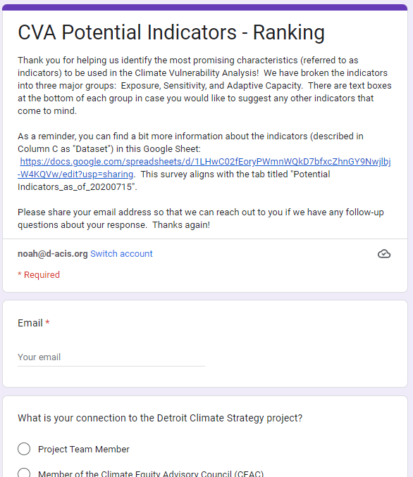
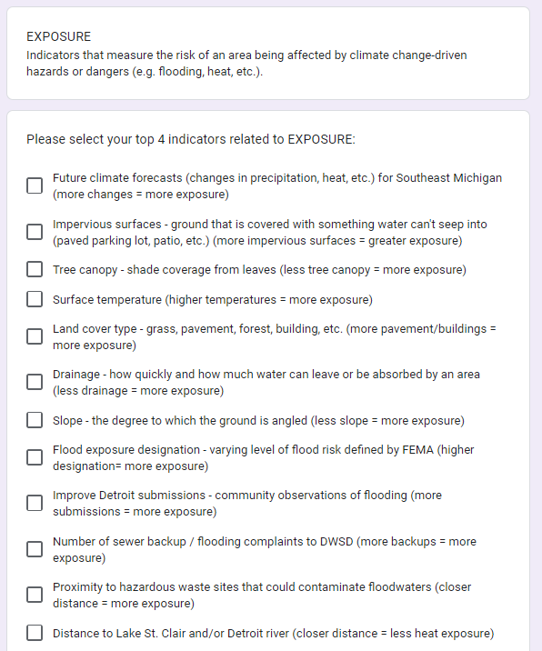
Step 2: Prioritize
Notes:
Then we administered a survey to help prioritize the indicators. We did this in two parallel processes: one survey for the project team and City of Detroit staffers (the experts), and one with the community.

Slide 7
Step 3: Identify Indicators to Pursue
Notes:
Once we had those results, prioritizing the indicators of greatest interest was easy! We reviewed them with the City and the project team, and ended up deciding to pursue most of the ones that had received the most votes (unless there was a strong methodological reason for excluding them). Also had engagement sessions with the community to talk through votes - turned out that certain things that seemed important weren’t actually that important following conversations!
Notes - this actually caused us to pursue some indicators that we hadn’t previously gone after at D3. And because we were working on a team that involved City stakeholders, we were able to get access to datasets that we’ve traditionally struggled to access.

Slide 8
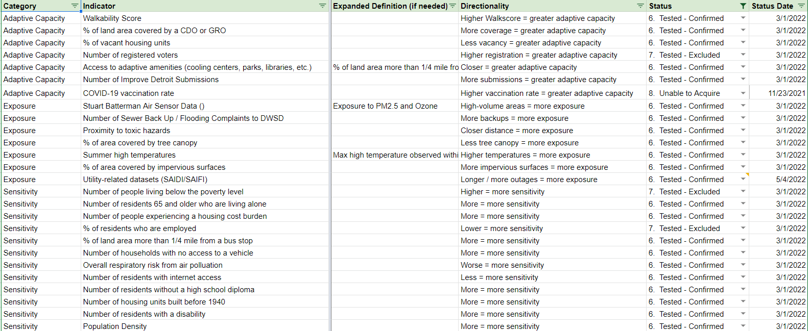
Step 4: Statistical Testing
Notes:
After this, we did multivariate regressions to identify correlations between indicators. We removed the ones that were too highly correlated unless there was a strong methodological reason to keep them in (for example, Tree Canopy and Impervious Surface)

Slide 9
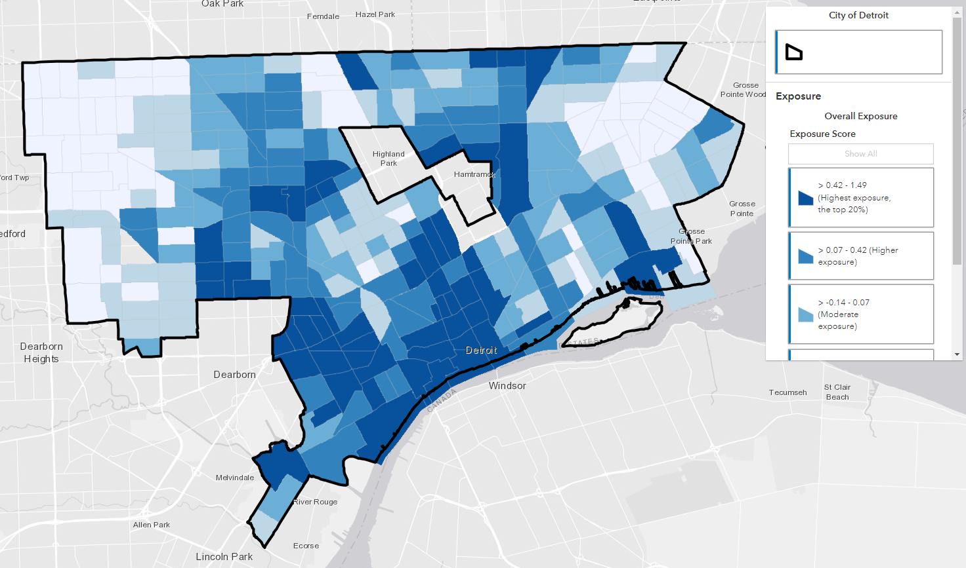
Step 5: Calculate the Indices!
Notes:
Then we calculated the indices! We used Z-scores to standardize the data, and then averaged the Z-scores in each dimension to create the actual measures for Exposure, Adaptive Capacity, and Sensitivity.

Slide 10
Step 6: Communicate Z-scores to a broad audience! (without offending anyone by using a 0-100 score)
We’re still working on that part…
Notes:
Now, all we have to do is figure out how to communicate this to a broad audience, without using a 0-100 scale. We’re working on this with our partners, and we think we’ve got some ideas, even if it’s still a challenging thing to think through.

Slide 11
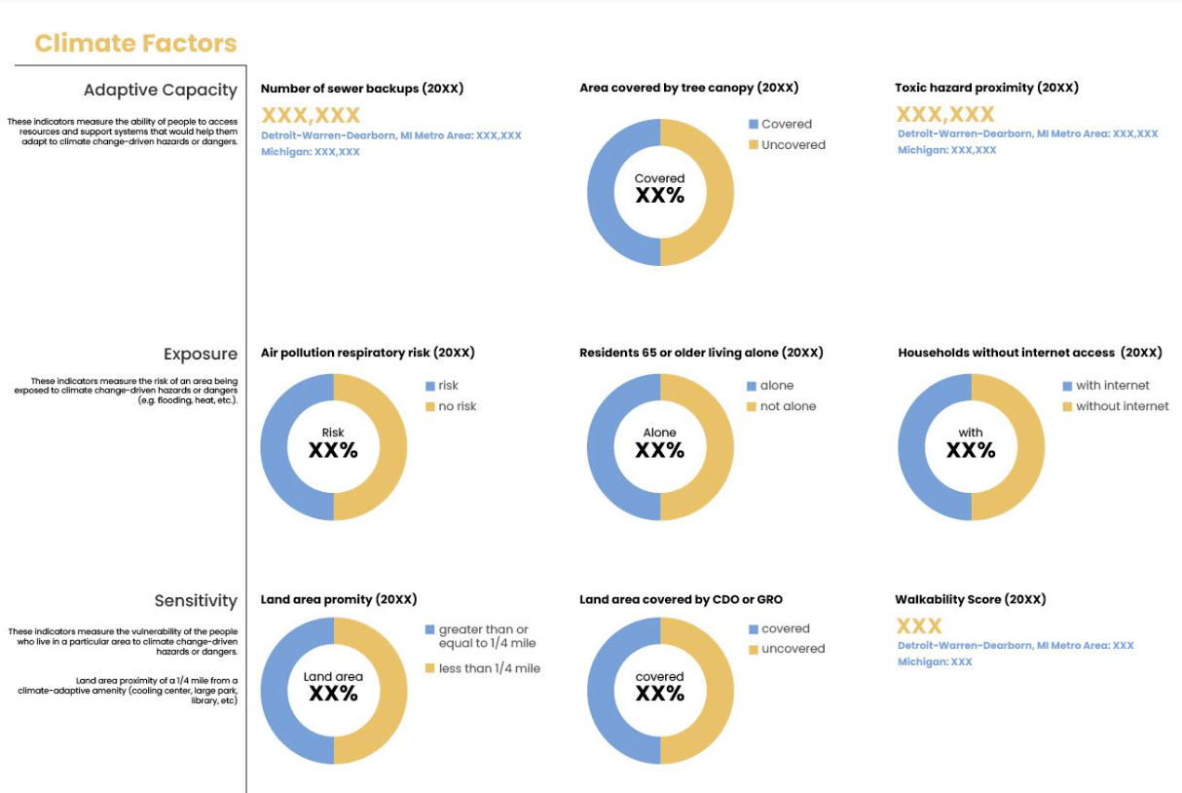
Step 7: Profit! (or, get the data out there!)
Notes:
And now we’re trying to figure out how we can integrate this into the rest of our work. For example, a lot of CDOs are interested in climate indicators, especially in certain parts of Detroit, so we’re working on adding them into the Housing Information Portal that we use to provide data to those CDOs. This is an early-stage mockup.
Now that we’ve done this work, we’re also exploring adding the indicators into other projects, too, including the Neighborhood Vitality Index that we’re working on building. And all of this from a $35K project!

Slide 12
Questions?
Noah Urban
noah@datadrivendetroit.org

