Slide 1
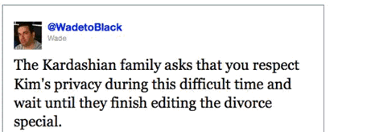
The Benefits of Using Twitter to Identify Data Needs
By Edwin Quiambao

Slide 2
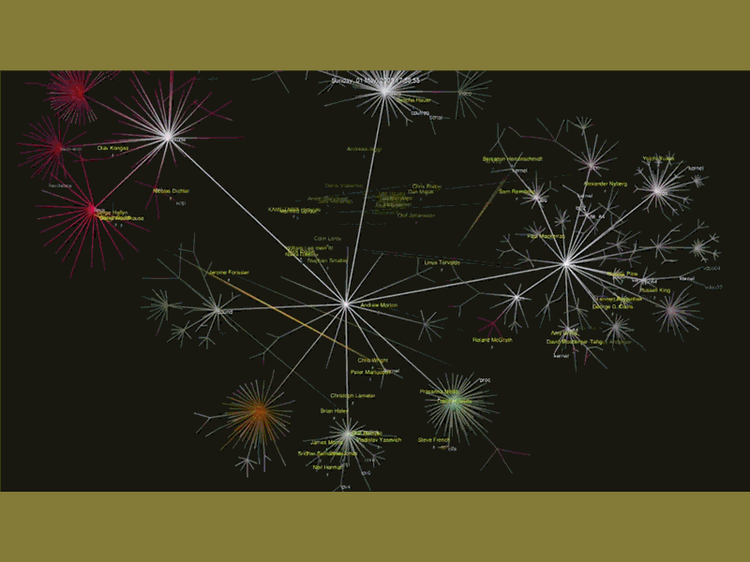

Slide 3
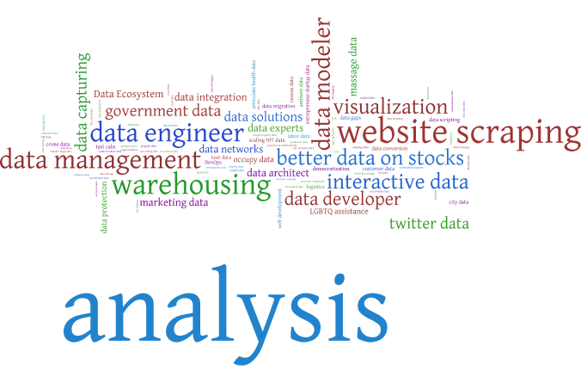
First Wordle: at the historical context we are in people are establishing data infrastructure by expressing the types of services needed

Slide 4
Second Wordle: I then removed service related tweets to dig deeper into the datasets laying just beneath

Slide 5
Relevance to NNIP
The question on WHEN to use data is relative to the dynamics of the situation
Understand emergent concerns, needs, biases around issues
Identify differing viewpoints that data needs to satisfy
Identify the changing perceptions and overlay with indicators

Slide 6
Relevance to NNIP
The question on WHEN to use data is relative to the dynamics of the situation
Understand emergent concerns, needs, biases around issues
Identify differing viewpoints that data needs to satisfy
Identify the changing perceptions and overlay with indicators
An intermediary for negotiation with potential communities and potential
Check if connection or disconnection from the communities you serve
Help support regional community development goals by helping to define what's going on in other communities
Identify data customers from people and organizations that tweet about data or your organization

Slide 7
Relevance to NNIP
The question on WHEN to use data is relative to the dynamics of the situation
Understand emergent concerns, needs, biases around issues
Identify differing viewpoints that data needs to satisfy
Identify the changing perceptions and overlay with indicators
An intermediary for negotiation with potential communities and potential
Check if connection or disconnection from the communities you serve
Help support regional community development goals by helping to define what's going on in other communities
Identify data customers from people and organizations that tweet about data or your organization
A DVR for Retrospective research
Identify emergent methods and technology around data
Explore perceptions on policy changes related to equity
Identify whether to add or remove indicators based on data need

Slide 8
How to Achive Tweets
VS
Anonymous and Unlimited

Slide 9
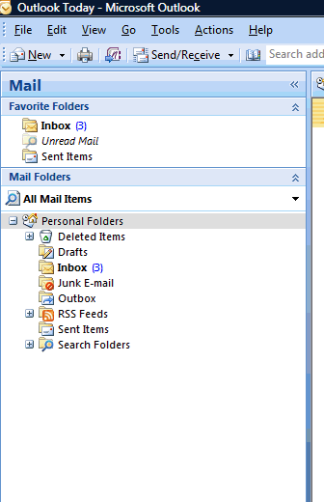
How to Collect tweets in Outlook via RSS syntax
Notes:
You do not need a Twitter account, just know the syntax to use for rss feeds Explain Outlook imports Explain Outlook archiving Explain Outlook exporting into access or Excel

Slide 10
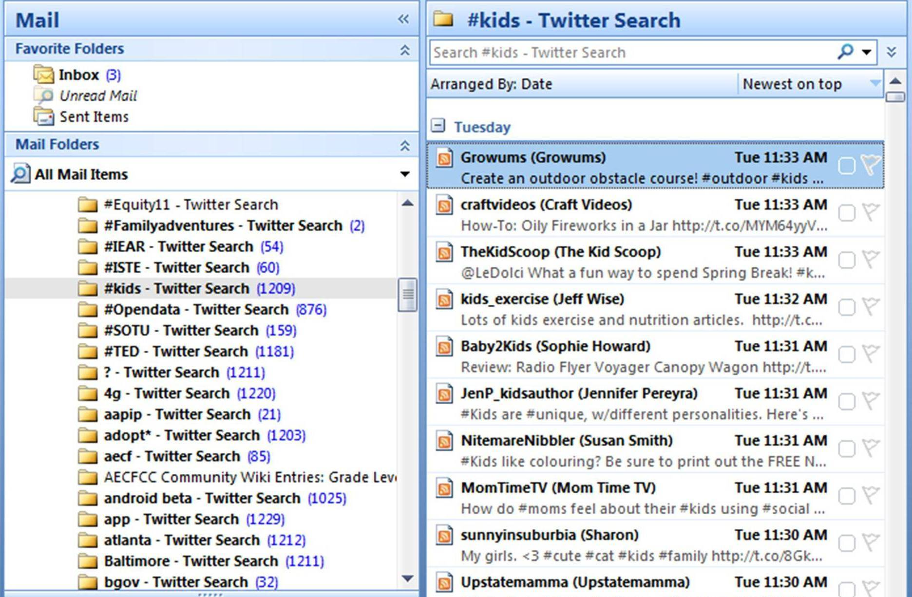
Archiving Twitter Feeds
Warning: Gigabytes of Data Need to be Archived into PST files

Slide 11
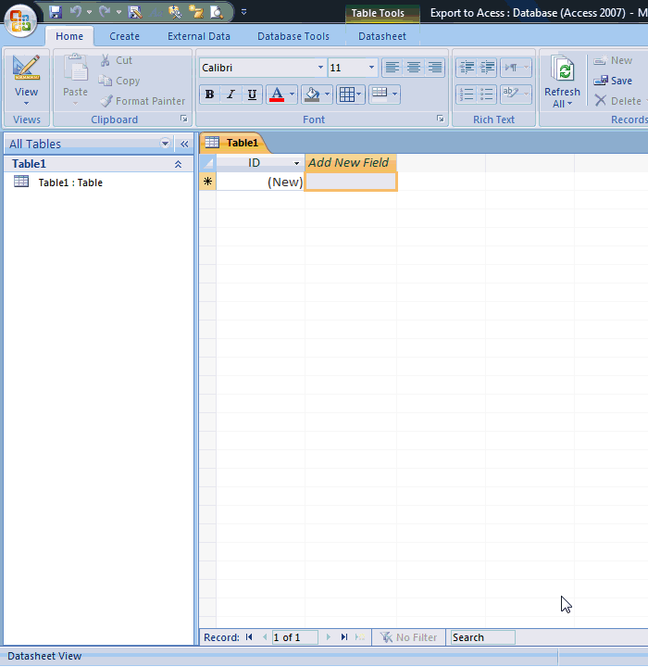
Exporting Feeds
Import into
Access

Slide 12
Prepping
Remove irrelevant tweets
Recode if necessary
Link w/ Other Tweet Datasets

Slide 13
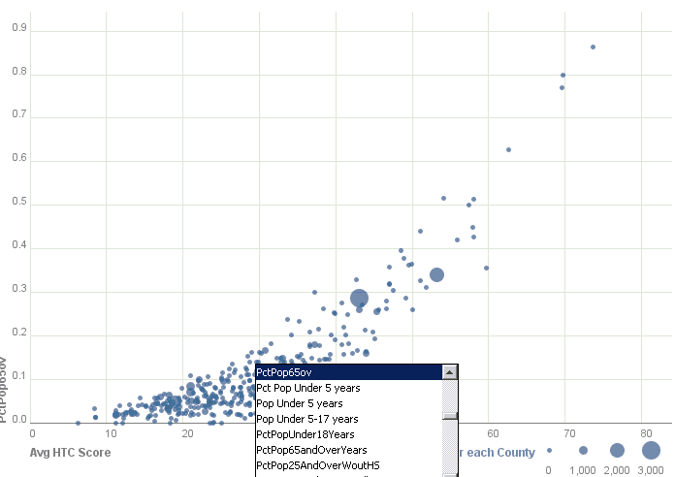
Analyses
Need Large N’s
Many Eyes
Tableau
Rapid miner

Slide 14
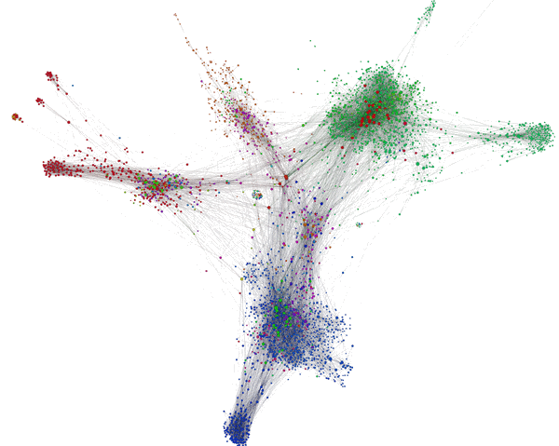
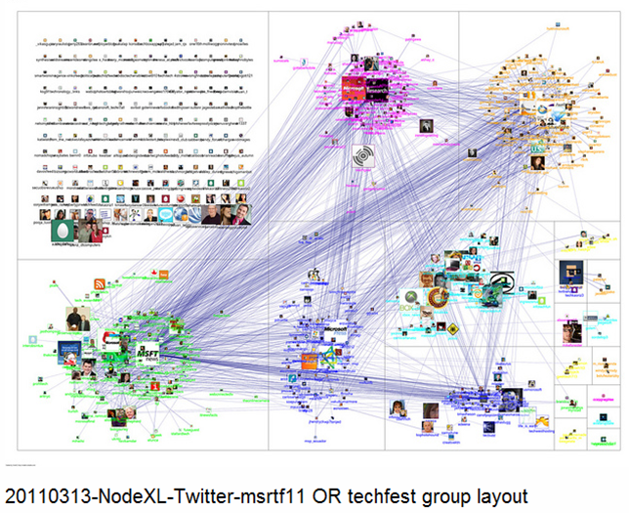
Complex Analyses
NODEXL
GEPHI

Slide 15
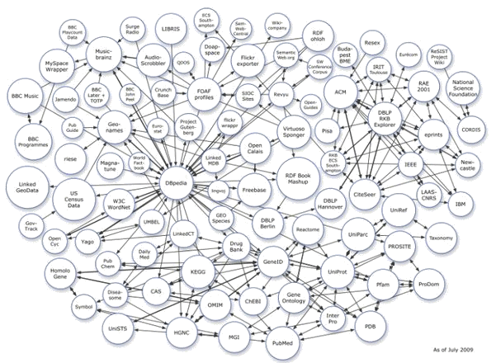
Potential
Customers
Minority
Subgroups
Polarizing
Issues
#Austin
Redevelopment/
Juvenile Justice
Data Needs
IN SUM
Identify Data Needs
Expand Customer Base
Linking Tweets via Relational Database

